Slide 1
JOINT MONITORING
COMMITTEE
PARTNERSHIP AGREEMENT 2014 - 2020
Partnership agreement 2021 - 2027
24 NOVEMBER 2023
www.eufunds.bg

Slide 2
OPTTI: Results Achieved
Reconstructed railway stations – 4 stations (Karnobat, Poduyane, Kazichene, Stara Zagora)
Total length of newly built roads, of which: TEN-T – 55,3 km (along the Struma Motorway, Europe Motorway and Sofia Ring Road)
Total length of newly built or modernized tram and metro lines – 13,1 km
New metro stations – 13 metro stations
Delivered multipurpose vessels - 5 vessels
Notes:
2

Slide 3
OPTTI: Reconstructed key railway station Stara Zagora
Notes:
3

Slide 4
OPTTI: Western Arc of Sofia Ring Road
Notes:
4

Slide 5
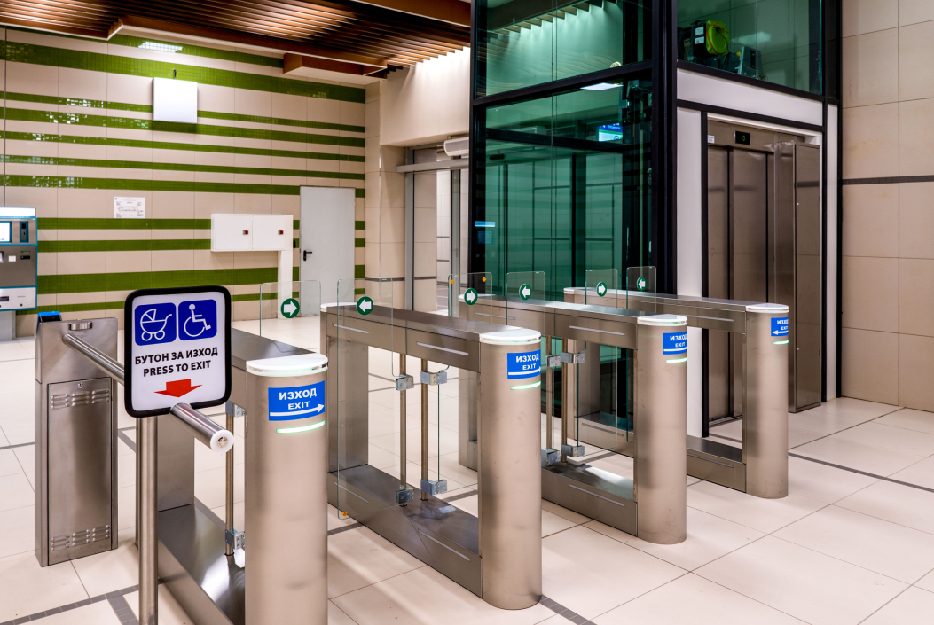
OPTTI: Extension of Sofia Metro
Notes:
5

Slide 6
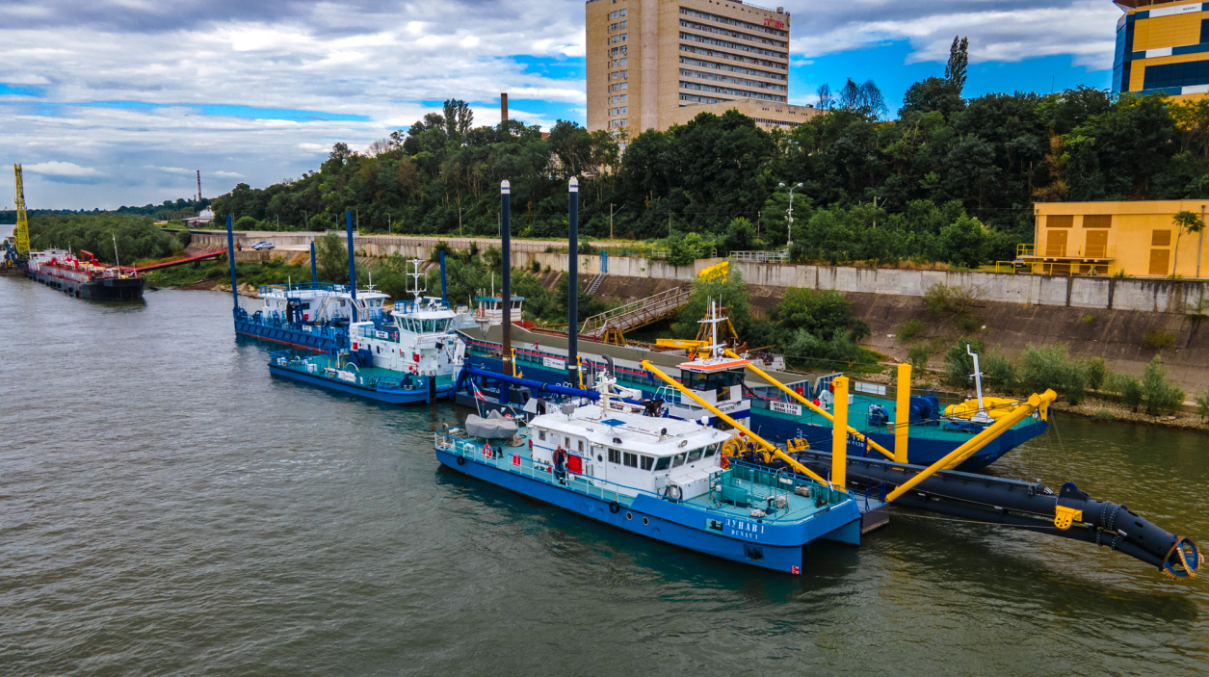
OPTTI: Dredging fleet for the Danube River maintenance
Notes:
6

Slide 7
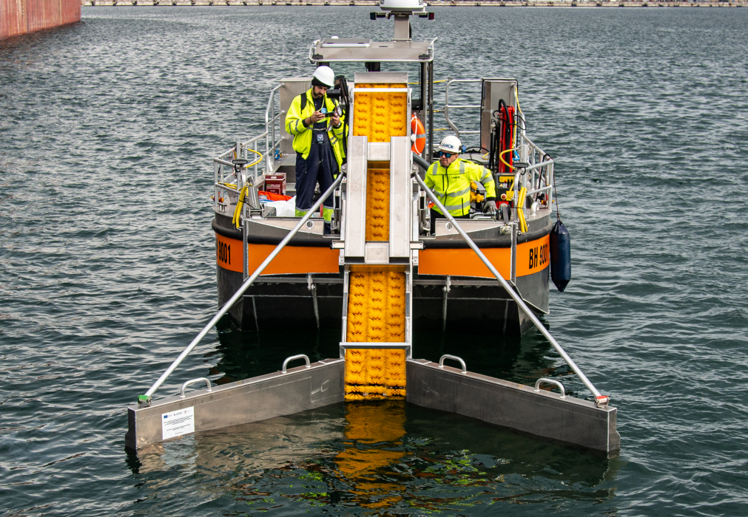
OPTTI: Port reception facilities
Notes:
7

Slide 8
OPE: Results Achieved
;
Priority axis 1 “Water”: 232 157 persons served by improved water supply; 793 970 PE served by improved wastewater treatment; 17 wastewater treatment plants have been built so far;
Priority axis 2 “Waste”: 101 640 tonnes/year additional waste recycling capacity; 55 landfills with completed technical recultivation subject to infringement procedure (case C-145/14);
Priority axis 3 “Natura 2000 and biodiversity”: 1,274,220.96 ha. surface area of habitats supported in order to attain a better conservation status; 1 607 836,08 ha. surface area of habitats of species supported in order to attain a better conservation status;
Priority axis 4 “Flood and landslides risk prevention and management”: 6 established centers for increasing the population preparedness for flood response; the population at risk of landslides decreased by 73 566 persons;
Priority axis 5 “Improvement of the ambient air quality”: 385 pcs. environmentally friendly vehicles will be delivered: 296 electric buses, 60 trolleybuses and 29 trams; replacement of domestic heating devices.
Notes:
8

Slide 9
OPRG: Results Achieved
823 Grant Contracts signed;
Contracted amount of BGN 3,144 billion or 99,88% from the total Programme budget;
600 projects finalized, 16 terminated и 207 under implementation;
The indicators included in the OPRG Implementation Framework were achieved except for 3 indicators which are expected to be achieved with the completion of the projects.
Measures were undertaken to minimize the risk of loss of Programme funds.
Notes:
9

Slide 10
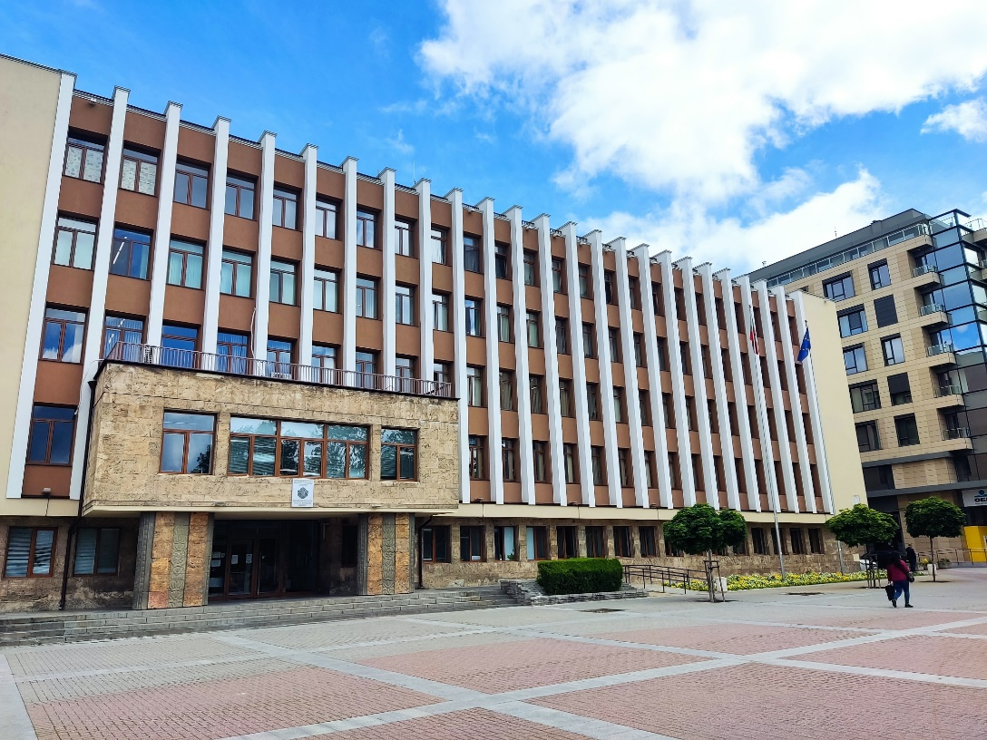
Indicators and projects OPRD 2014-2020
Indicator „Decrease of annual primary energy consumption of public buildings (kWh/year)“ Priority axis 1 – achieved at 162,8%
Project BG16RFOP001-1.012-0006-C04 „Introducing energy efficiency measures for a building of the Haskovo Regional Administration“ with the beneficiary municipality of Haskovo
Notes:
10

Slide 11
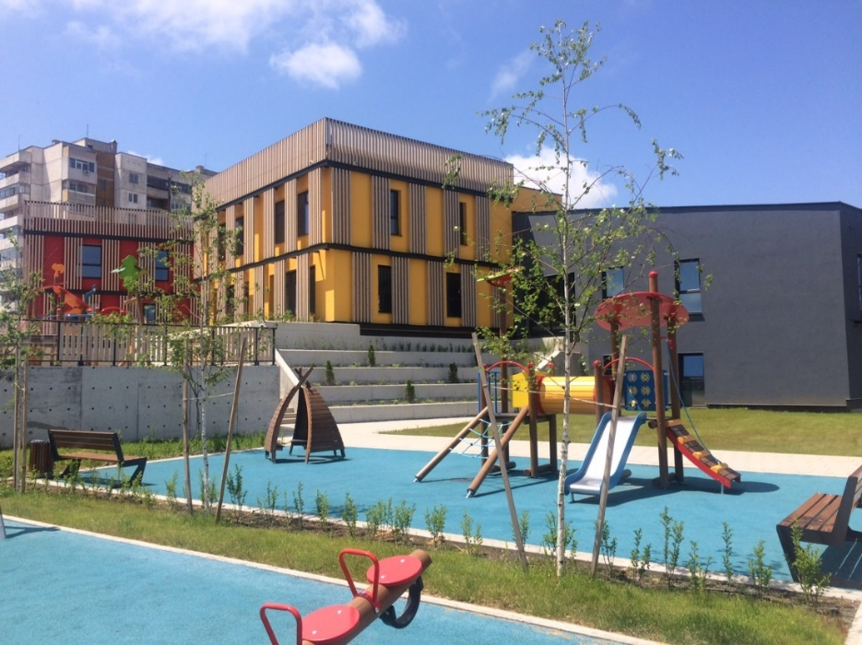
Indicators and projects OPRD 2014-2020
Indicator „Capacity of supported childcare or education infrastructure (persons)“ Priority axis 1 – achieved at 101,4%
Project BG16RFOP001-1.004-0001-C01 „Improving the quality of education through modernization of educational infrastructure in the city of Burgas stage I“ with the beneficiary municipality of Burgas
Notes:
11

Slide 12
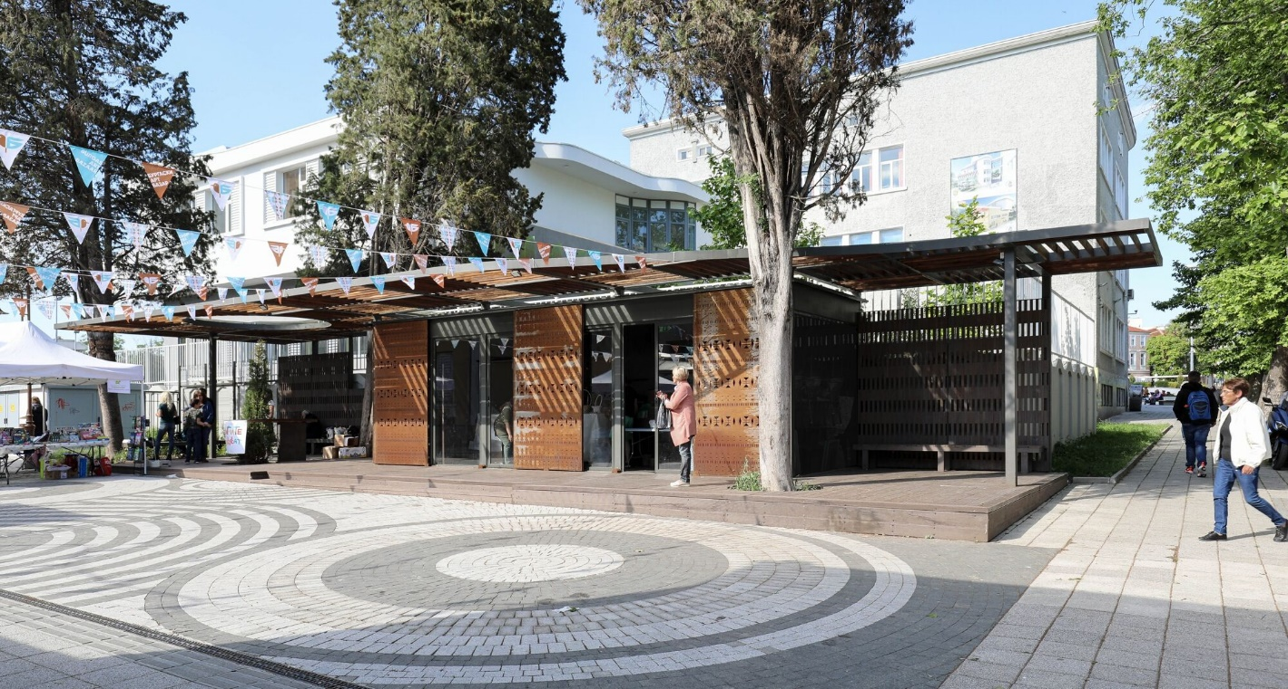
Indicators and projects OPRD 2014-2020
Indicator „Open spaces created or rehabilitated in urban areas (square metres)“ Priority axis 1 – achieved at 98,9%
Project BG16RFOP001-1.004-0003-C01 „Providing a balanced urban environment in the city center, Vazrajdane and Meden rudnik residential areas- phase I“ with the beneficiary municipality of Burgas
Notes:
12

Slide 13
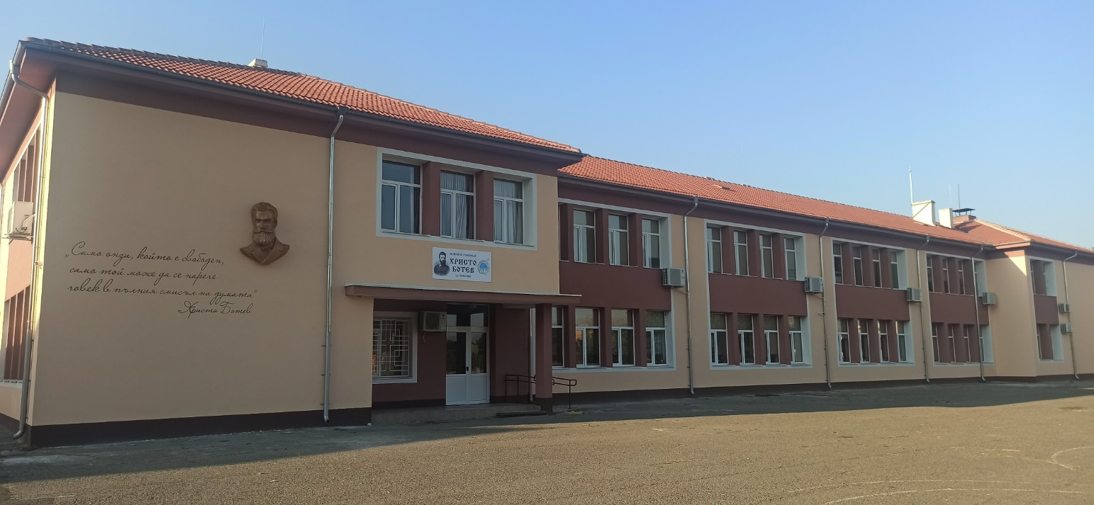
Indicators and projects OPRD 2014-2020
Indicator „Decrease of annual primary energy consumption of public buildings (kWh/year)“ Priority axis 2 – achieved at 110,8%
Project BG16RFOP001-2.003-0016-C02 „Implementation of energy efficiency measures for Hristo Botev Primary School in Pomorie and multi-family residential buildings in Pomorie with address: 9 Solna Str. And Svoboda Quarter 14“ with the beneficiary municipality of Pomorie
Notes:
13

Slide 14
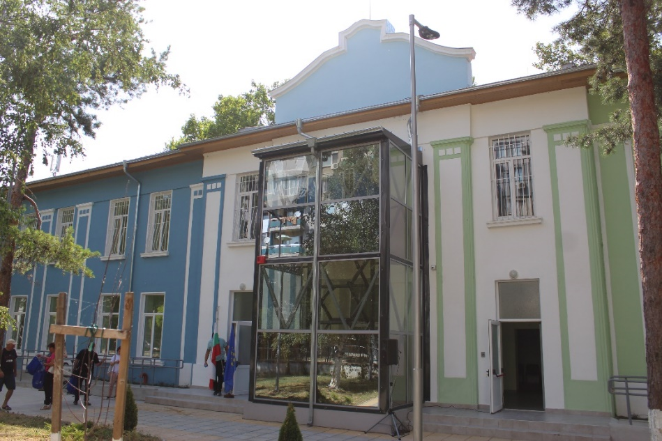
Indicators and projects OPRD 2014-2020
Indicator „Number of supported facilities of social infrastructure in the process of deinstitutionalization“ Priority axis 5 – achieved at 93,4%
Project BG16RFOP001-5.002-0025-C01 „Providing infrastructure for community social services for elderly people and people with disabilities /in accordance with the Strategic document for resident services and the Strategic document for community services/ on the territory of Ruse municipality: - one Care centre for people with mental disorders (CCPMD); - one Care centre for people with different types of dementia (CCPTD)“ with the beneficiary municipality of Ruse
Notes:
14

Slide 15
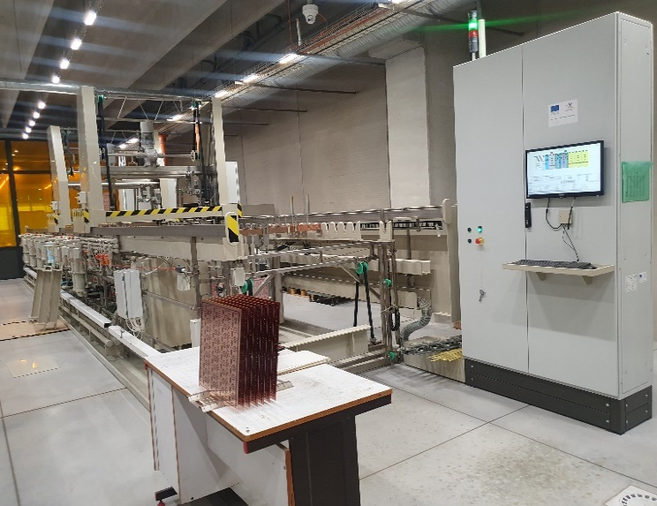
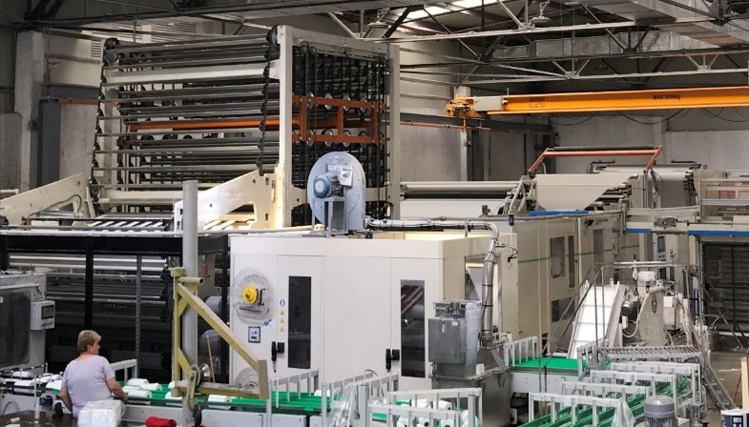
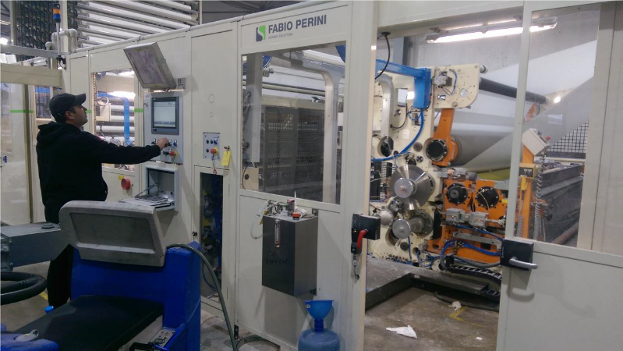
OPIC: Results Achieved
33 324 completed and supported projects
265 enterprises cooperating with research institutions
135 enterprises supported to introduce new to the market products
451 new enterprises supported
29 320 supported SMEs with grants for working capital
86 Implemented pilot and demonstration initiatives
29,60 кm constructed gas interconnector Greece – Bulgaria from overall length of 182,5 кm
Notes:
15

Slide 16
OPHRD: Results Achieved
The number of participants in OP HRD measures exceeded 890,000, with every second person included in measures on the labor market, and over 239,000 in measures to prevent social exclusion. Highlights:
over 95,000 young people up to 29 years old covered by operations, and over 15,000 of them have found a permanent job;
over 41,000 persons belonging to the Roma ethnic group included in operations, most of whom received and are receiving complex services in the areas of the labor market, social inclusion and health care;
over 55,000 children and their families were covered in early childhood development services, and over 12,000 more participated in measures to support the deinstitutionalization process;
over 230,000 people were directly supported in measures to overcome the consequences of the COVID-19 pandemic
Notes:
16

Slide 17
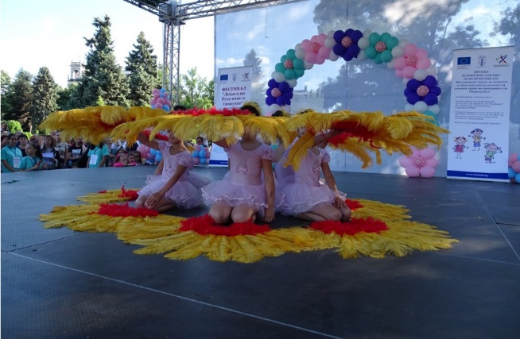
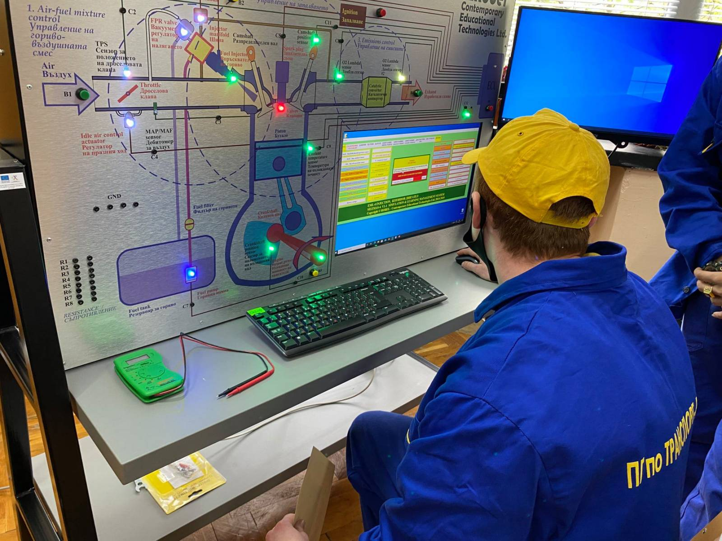
OPSESG: Results Achieved
451 498 students, involved in activities to increase the motivation for learning, through the development of specific knowledge, skills and competences.
82 286 children, students and youth from marginalized communities, incl. Roma, participating in educational integration and reintegration measures
45 774 pedagogic specialists, included in programs to increase their qualifications
21 769 students and 89 133 students, participated in practices in a real work environment
Built 10 Centers of Excellence and 6 Centers of Competence (ERDF)
BG05M9OP001-2.056-0007 Ruse Municipality
Vocational School of Transport – Ruse, dual training
Notes:
17

Slide 18
OPGG: Results Achieved
Supported registers – 115
E-services supported, available in transactional regime – 435
Number of administrations supported for implementation of organizational development mechanisms and result-based management – ​​174
Number of supported e-services of the judiciary – 28
Developed Unified information system of courts - 1
Introduced new and improvement of existing tools for modernization of the judiciary – 60
Visualisation – project photo or programme logo
Notes:
18

Slide 19
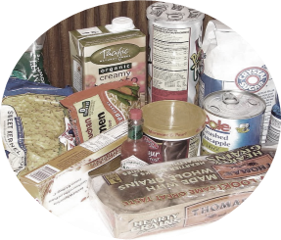
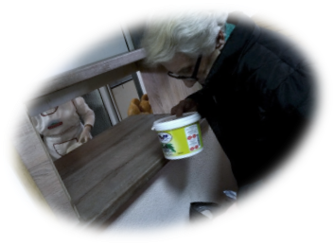
FEAD: Results Achieved
On average, more than 55,000 people received a hot lunch each year and during the COVID-19 crisis, the number reached 70,000.
On average, 500 000 people and their family members received food packages each year.
Vouchers were provided for 35 566 persons from Ukraine for
the purchase of essential goods.
Notes:
19

Slide 20
RDP: Results Achieved
Investments in modernization and increasing competitiveness in the production and processing of agricultural products - 1,994 billion euro (3,590 active contracts).
A total of 2,280 young farmers helped to enter the sector with subsidy equal to € 57 million.
A total of 4,720 small farmers holdings received support (€ 70 million) aiming to market-oriented activities.
Supported 25 innovation projects, presented by operational groups for cooperation between farmers, scientists and teachers and the bussiness, worth over € 7,5 million.
Improving the quality of life in rural areas - supported 809 infrastructure projects worth over 685 million euros.
Supported 240 projects of micro-enterprises for non-agricultural activities in the field of services and production in rural areas (over 66 million euros investments).
Over € 1,1 billion paid to farmers under “compensatory” and area-based measures from the BG RDP 2014-2020 - for commitments related to environmental protection, implementation of organic farming methods, animal welfare, compliance with restrictions in Natura 2000 areas, compensation for unfavorable conditions in areas with natural constraints in the country, etc.
Notes:
20

Slide 21
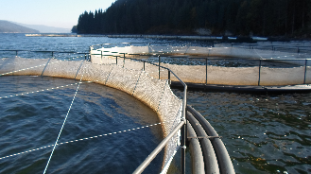
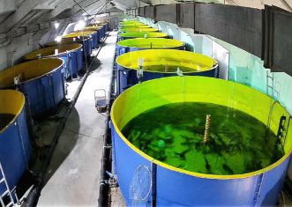
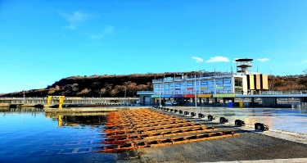
MFP: Results Achieved
88 supported aquaculture producers and 22 new ones
36 modernized processing plants
4 aquaculture farms providing environmental services
184 projects supported under the CLLD strategies
123 new jobs created
130 jobs saved
2 newly created Producer Organizations
295 compensation provided in relation to the COVID-19 crisis
Notes:
21

Slide 22
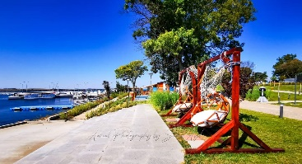
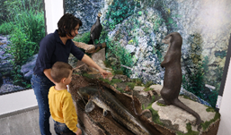
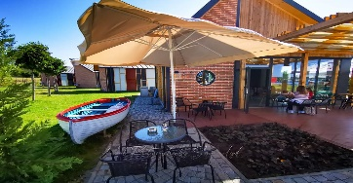
MFP: Results Achieved
6 modernized fishing ports
5 built/upgraded moorings
8 scrapped old ships
7 projects to increase knowledge about the marine environment
Implemented integrated Bulgarian maritime surveillance, as part of the Common Information Sharing Environment (CISE)
Notes:
22

