Slide 1
JOINT MONITORING
COMMITTEE
PARTNERSHIP AGREEMENT 2014 – 2020
Partnership agreement 2021 - 2027
24 November 2023
www.eufunds.bg

Slide 2
Main findings and recommendations of the audit authority for erdf, cf, esf and FEAD (2014 – 2020)
Katya Doychevska
Executive director
AUDIT OF EU FUNDS AGENCY

Slide 3
Audit activities
For programming period 2014-2020, 1-8 accounting year (AY) – 9 operational and 3 CBC programmes: 73 system audits (82 CBC incl.) and 51 audits of operations (53 CBC incl.), 1310 checked projects.
For 9th AY – 12 audit of operations and 9 system audits.
The identified gaps – individual and systemic – are addressed with appropriate recommendations, all of which are fulfilled.
Management and control system assessment: Category 2 „ Works, but some improvement(s) are needed. “
High projected error rates:
- Innovations and Competitiveness OP: ACR 2018/2019 – 4,20%, ACR 2020/2021 – 2,19%
- Regions in Growth OP: ACR 2019/2020 – 2,43%
- Environment OP: ACR 2020/2021 – 4,72%; ACR 2020/2021 – 3,56 %
- CBC programmes for Bulgaria, Serbia, North Macedonia and Turkey : ACR 2022/2023 – 2,77 %.
Notes:
3

Slide 4
Audit activities
For RRP – 5 system audits и 1 audit of milestones and targets;
The Management and Control System assessment of 4 Monitoring and Reporting Structures is Category 2 „Works, but sum improvements are needed“ and 1 MRS`s MCS assessed in Category 3 „Works partially: Substantial improvements are needed“;
The identified gaps – individual and systemic – are addressed with appropriate recommendations.
Notes:
4

Slide 5
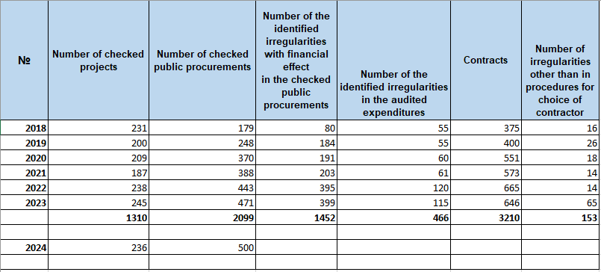
Audit activities
Notes:
5

Slide 6
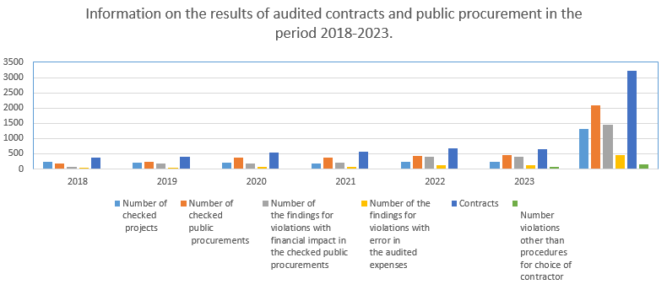
Audit activities
Notes:
6

Slide 7
Audit activities
Public procurement law related
Others
Notes:
7

Slide 8
Individual audit findings
Non-compliance with public procurement legislation (incl. Council of Ministers Decree № 160/2016) – most frequent;
lack of PP procedure, incorrect type of PP or irregular splitting
irregular shortening of the deadlines;
restrictive selection criteria and unlawful tender evaluation methodology;
unlawfully excluded participant;
the winning bid does not meat all requirements of the Contracting Authority;
irregular modification of contract – substantial change in price, subject-matter, completion period, payment conditions.
Notes:
8

Slide 9
Individual audit findings
Notes:
9

Slide 10
Individual audit findings (2)
Ineligible beneficiary/final recipient (person does not belong to the target group);
Ineligible costs (region, category, period, not related with project, double declared expenditure, business trips expenditure, remunerations);
Products/services/works not delivered or partially delivered;
Bad physical condition of the investment;
Missing assets;
MA did not implement its own decision for financial correction and the expenditures have been wrongfully re-introduced in the programme;
Conflict of interest (the head of the beneficiary’ partner concludeа service contract with himself and paid to himself)
Notes:
10

Slide 11
System audit findings
FEAD OP - error in public procurements (PP) for purchase of food products for preparation of hot lunch (2nd AY, ACR 2015/2016) with insignificant financial effect – introduced SCO
Regions in Growth OP – error in PP – improvements (methodology, trainings) and reverification of all PP expenditure (3rd-4th AY, ACR 2016/2017 and 2017-2018)
Science and Education for Smart Growth OP
- deficiencies in the selection process of the first 3 calls under the OP (unclear assessment methodology) – 6 non-eligible projects and 10 % flat rate FC on the remaining 139 projects (3rd AY, ACR 2016/2017)
- error in public procurements (5th-6th AY, ACR 2018/2019 and 2019/2020) – improvements and reverification of all PP expenditure
Notes:
11

Slide 12
System audit findings
OPE – error in procurement (OP) for 20 contracts (8 AY, ACR 2021/2022). Improvements in the area of public procurement checks and reverification of 44 contracts. Irregular expenditures were withdrawn from the Annual Accounts.
OPIC – the error is limited within the framework of procedure BG16RFOP002-2.073 "Support for micro and small enterprises to overcome the economic consequences of the pandemic COVID-19" (8 AY, ACR 2021/2022). All irregular expenditures under the procedure concerned have been withdrawn.
CBC between Bulgaria and Turkey, North Macedonia and Serbia - the error related to deficiencies of the Bulgarian first level control system in checking for conflicts of interest in small PRAG procedures - single tender procedures (8 AY, ACR 2021/2022). The irregular expenditures have been withdrawn from the Annual Accounts.
Notes:
12

Slide 13
Effect of AA corrections (1-7 AY)
27 768 524,85 EUR - amount withdrawn from the Annual accounts as a result of financial corrections (this is only the effect in the respective accounting year – financial corrections proposed by the AA in previous years are not included),
7 847 940,59 EUR - amount withdrawn from the Annual accounts as a result of extrapolated financial corrections, proposed by the AA in addition to the individual FC, in order to decrease the Residual total error rate below 2 %,
* The overall amount withdrawn is 57 936 194,14 EUR, out of which 49,72 % due to AA findings and recommendations.
Notes:
13

Slide 14
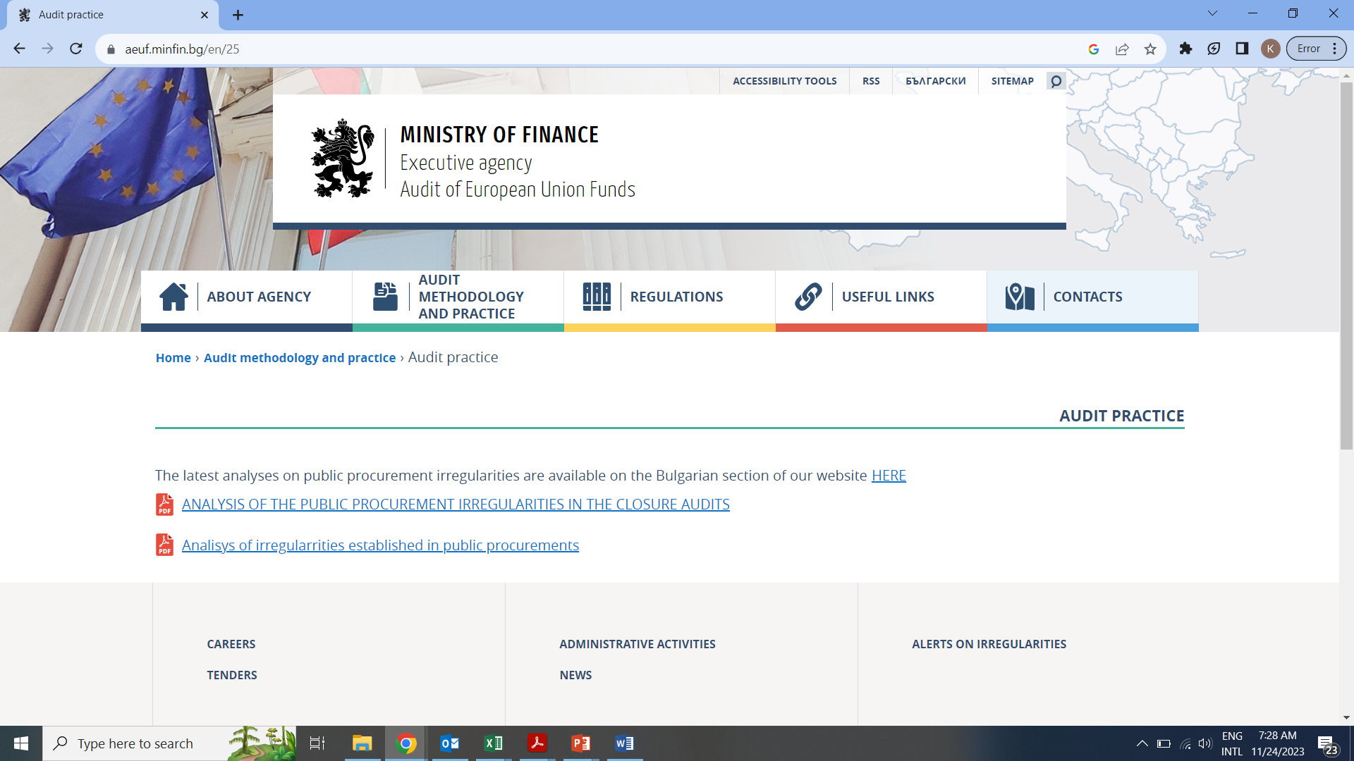
THANK YOU FOR THE ATTENTION!
https://aeuf.minfin.bg/bg/25
Notes:
14

