Slide 1

Evaluation on the impacts of transport sector investments: transversal aspects of evaluation
Miryam Vahtra, State Budget Department, Ministry of Finance of Estonia
Notes:
Maaelu logod ka peale

Slide 2
The study “Impact Assessment of EU-funded
Transport Investments“
Evaluation of the efficiency, effectiveness, impact and sustainability of structural fund investments made in the Estonian transport sector.

Slide 3



Evaluators

Slide 4
Scope of the evaluation
Structural funds investments planned for airports, waterway, road, railway and light traffic infrastructure during the 2007-2013 and 2014-2020 programming periods.
Success of implemented projects:
Traffic intensity & infrastructure capacity;
Time savings;
Traffic safety;
Entrepreneurship;
Use of public transport & light traffic;
Environmental impact.
Notes:
Site specific environmental impacts were not conducted.

Slide 5
Methods
Possible impact was established based on descriptive statistics from public databases (Statistics Estonia, Tallinn Airport, AS Saarte Liinid, Estonian Road Administration road registry, etc)
Impact on businesses - data from commercial register (turnover, profit, number of employees) & spatial analysis tools
Time-space distances - map layer by the Road Administration and special time-distance model
Face to face and telephone interviews with 50 entrepreneurs

Slide 6
Methods (2)
Light traffic counting on 18 sites - video counters & border patrol mobility sensors.
Traffic safety - number of accidents and consequences before and after 2007-2009 & 2015
Traffic intencity of road objects - traffic counting census data from Estonian National Road Registry and mobile positioning

Slide 7
Spatial analysis
Businesses were located on the map based on their address data.
Economic indicators of businesses located in the expected impact areas were compared with indicators of businesses that fall outside those areas.
Potential impact was compared for all projects in one temporal dimension: 2007 and 2015.

Slide 8
The economic indicators of business located in the vicinity of transport infrastructure do not differ significantly from the region average

Slide 9
Transport infrastructure is a necessary, but not a sufficient driver of economic growth.
Although a functioning transportation Network is important, surveyed companies were of the opinion that other business environment related factors, such as tax burden, Access to public services and workforce, serve a more important role as prerequisites for sparring economic development.
RECOMMENDATION: Transport investments will not spur local business, but will offer critical support when economic activities intensify. Therefore, transport infrastructure must be in line with demand, instead of becoming a bottleneck for business development

Slide 10
Traffic intensity and mobile positioning
Each object under evaluation was designated a servicing mobile mast which was used to identify the overall number of call activities and on the monthly basis calculate the average number of daily visitors at airports, ports etc
RECOMMENDATION: In estimating traffic intensity it should be used a more user-centred approach, by focusing on mobility demands arising from spatial planning and socio-economic trends and estimate people´s possible mobility trajectory by combining national databases with mobile positioning data.

Slide 11
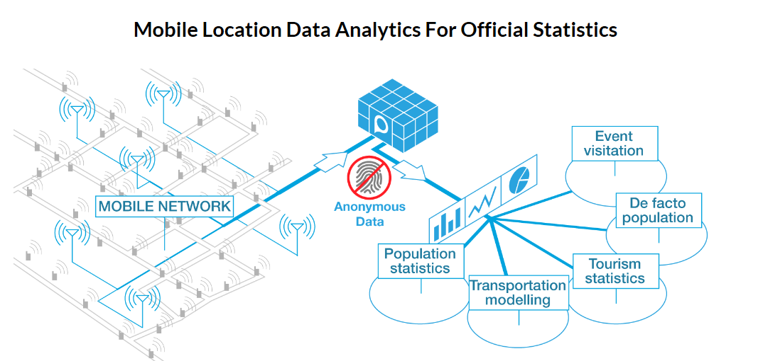
https://www.positium.com

Slide 12
Mobile positioning in evaluation
Turns billions of location points into meaningful and understandable statistics - tourism management, spatial planning, transportation modelling, safety and security analyses etc.
Learn where people are coming from and where they are going. The origin-destination model used to analyse mobility can help to understand popular routes and provide basis for better transportation modelling.
The no of permanent residents in a specific municipality, work-time anchor points, secondary homes, summer houses, de facto population.
People at a specific time at a specific location, broken-down - permanent residents, workers, temporary residents, visitors, transit.
Notes:
In Estonia used for example to analyse movement between counties and also by Police and Boarder Guard.
Activities: call, SMS etc
Location according to mast, in each 5 seconds, country, generated ID
home during 7 months
Home during 2 months
Visits – not anchor
Non-estonian ID
Transit – sum inb+dom

Slide 13
Contact of the company who carried out the analysis for the Ministry of Finance of Estonia
Positium
Phone: +372 7341144
Email: positium@positium.com
Erki Saluveer, CEO - erki.saluveer@positium.com

Slide 14
Use of map layers and special time-distance model
How much time distance from major centres (Tallinn, Tartu, Pärnu and Jõhvi) has changed during 2007-2015
How far it is possible to get from these centres within a 30, 60 and 120 minute drive
RESULT - changes in distances and speed limits were marginal

Slide 15
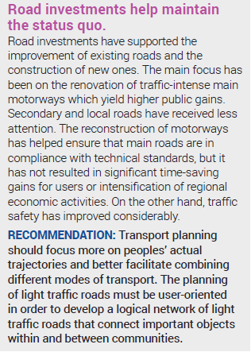
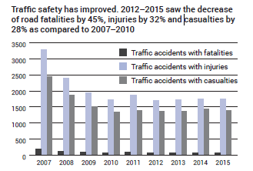

Slide 16

Traffic counts
Carried out in 2016 in two stages - sept/oct & nov/dec.
7-day cycles on 7 consecutive days 24 ours per day
Highest traffic frequency between 10am and 8 pm - presents 72-74% of actual traffic volume.
6-hour maximum traffic period in the range of 14-20 would probably be 44-47% of the daily rate.
The counting system is unable to distinguish between different objectives for mobility - therefore counting should be accompanied by survey
Notes:
Divided in two - those located in urban areas and others along highways.

Slide 17
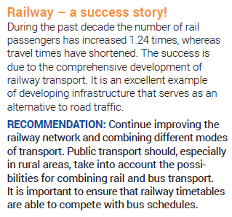
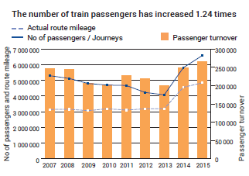

Slide 18
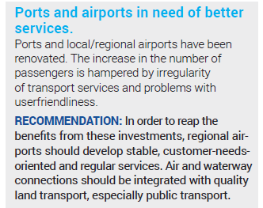

Slide 19
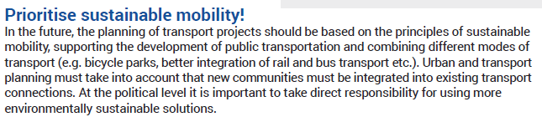

Slide 20
Thank You for Your attention!
Miryam Vahtra
Phone: +372 611 3047
E-mail: Miryam.Vahtra@fin.ee

