Slide 1
Evalution procedures
OP Integrated infrastructure 2014 – 2020
Study visit - Taiex Regio
27-th – 29-th May 2019, SOFIA

Slide 2
OP Integrated Infrastructure - Introduction
Global objective
support of sustainable mobility, economic growth, job creation and improving the business environment through progress in transport infrastructure, public passenger transport and development of an information society
8 priorities
22 specific objectives
4 646 130 079 € total budget
3 949 210 563 € EU funds

Slide 3
OP Integrated Infrastructure - Introduction
Key elements in implementation of transport projects
Feasibility studies
Public procurement
Major projects
Cooperation with JASPERS
Meetings with EC

Slide 4
OP Integrated Infrastructure - Introduction
Institutional management of OPII
:national level
OPII
Managing authority
Intermediary body of OPII
MTC SR
ÚPVII
EC regulations
Control
Beneficiaries
Beneficiaries
Audit authority
Coordination body
Certifying organ

Slide 5
Ministry of Transport and Construction
Project management divison
Department of Programme Programming and Monitoring
Department of Road and Water transport projects
Department of Railway and Public passenger transport projects
Department of Information society projects
Department of coordination and managing projects
Department of Technical assistance projects
OP Integrated Infrastructure - Introduction
Institutional management of OPII
:MA level (streamlined scheme)
:
(Streamlined scheme)
Main Principles:
PIFC, Empowered Society
OPII amendments
Monitoring of performance
Project management
Comunication with beneficiaries
Project management
Comunication with beneficiaries
Comunication with intermediary body
Managing of ESIF methodology issues
Project management
Supporting of OPII implementation

Slide 6
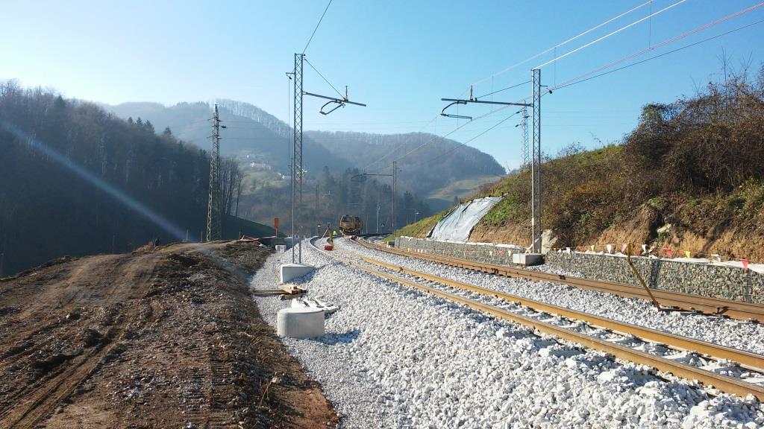
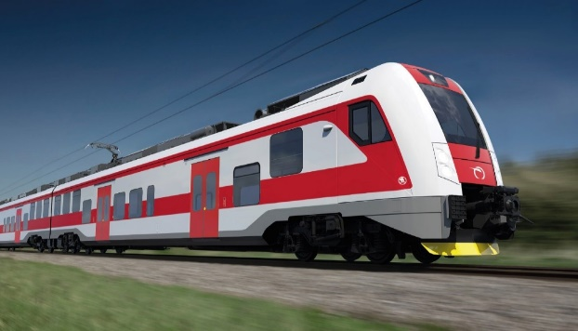
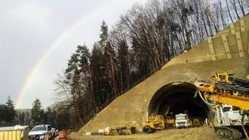
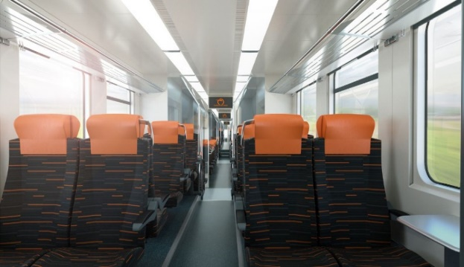
OP Integrated Infrastructure - Introduction
Main activities supported by OPII
PA1 - Railway infrastructure (TEN-T CORE) and rolling stock renewal
Modernization of main railway corridors and nodes
Renewal of rolling stock for rail transport
Using of financial instruments
Budget: 853 928 431 €
Contracted: 77 %

Slide 7
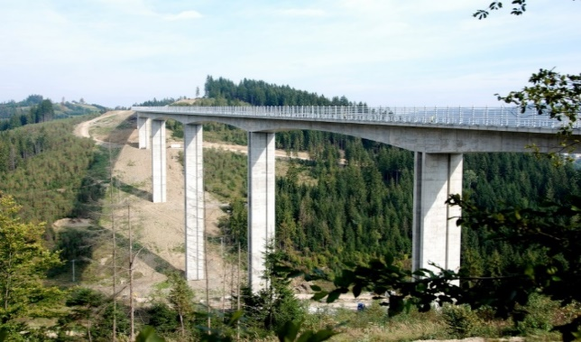
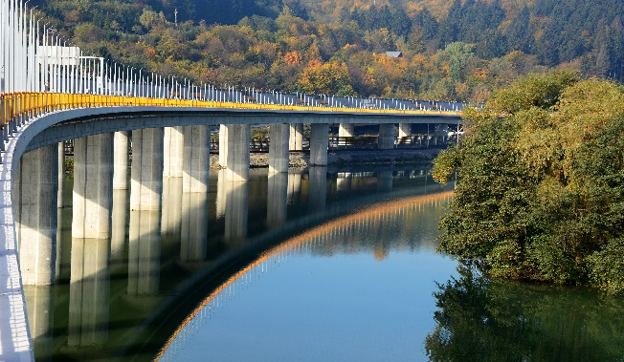
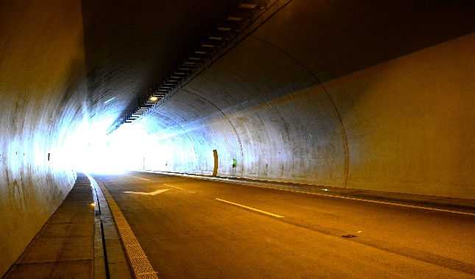
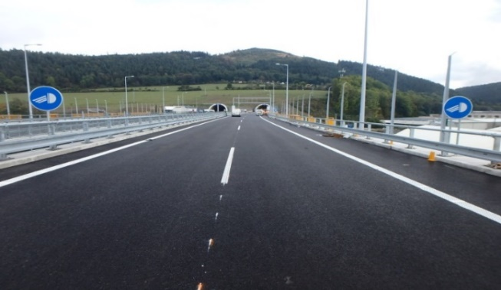
OP Integrated Infrastructure - Introduction
Main activities supported by OPII
PA2 - Road infrastructure (TEN-T)
Construction of new sections of motorways (D1, D3, D4)
Phased major projects type
Using of financial instrument
Budget: 1 344 117 648 €
Contracted: 115 %

Slide 8
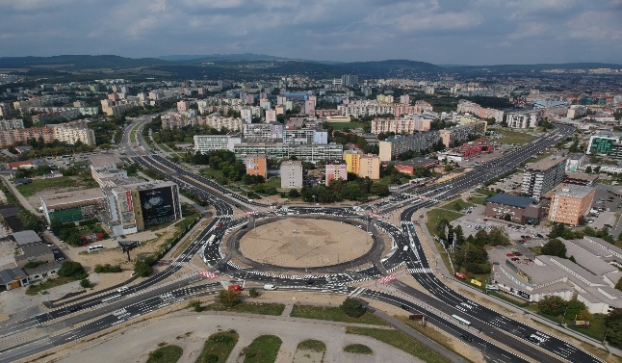
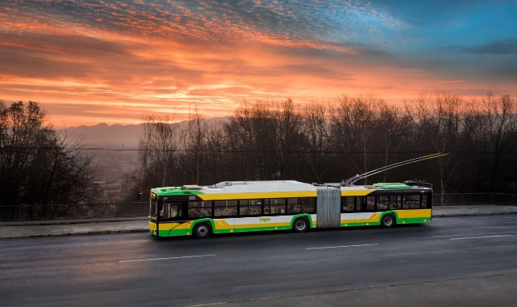
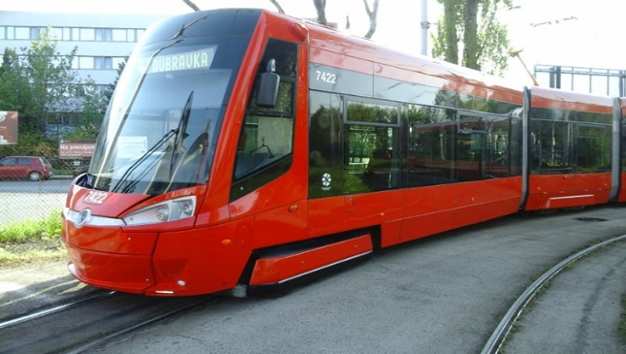
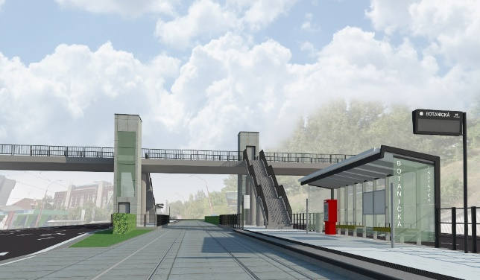
OP Integrated Infrastructure - Introduction
Main activities supported by OPII
PA3 - Public Passenger Transport
Support of urban mobility by construction and modernisation of infrastructure for integrated transport systems, renewal of rolling stock for public transport, construction of transfer terminals
Budget: 379 235 295 €
Contracted: 48 %

Slide 9
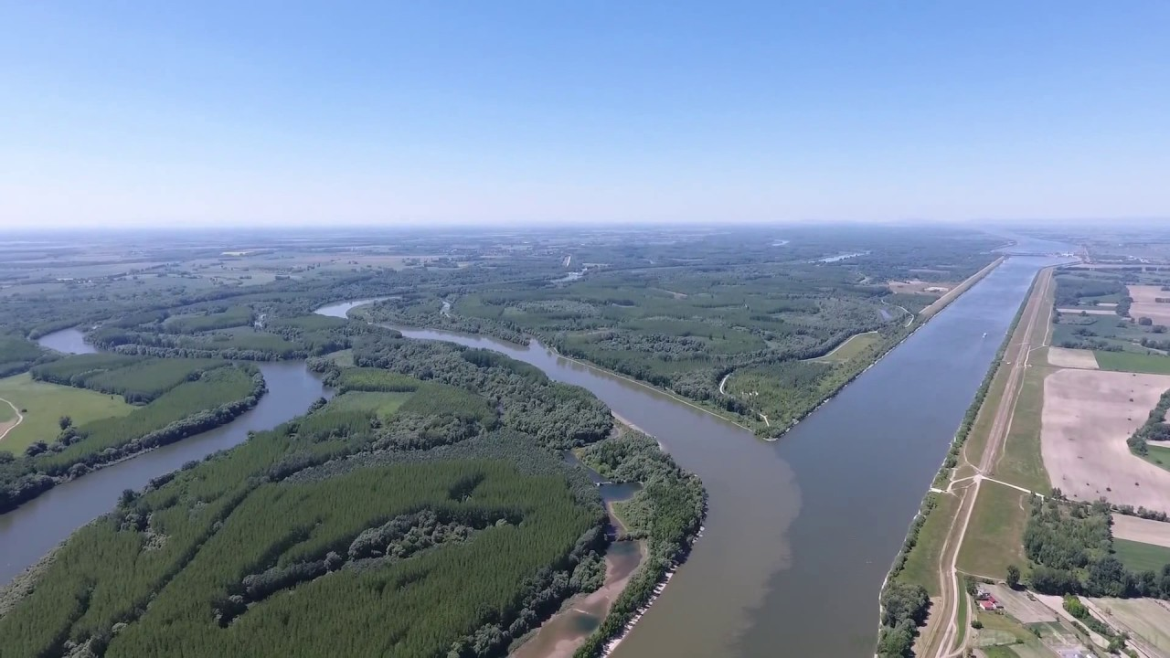
OP Integrated Infrastructure - Introduction
Main activities supported by OPII
PA4 - Waterway transport infrastructure (TEN-T CORE)
Development of inland waterway infrastructure (Danube river, Bratislava Port)
Passenger water transport services (DunajBus)
Budget: 137 000 000 €
Contracted: 0,4 %

Slide 10
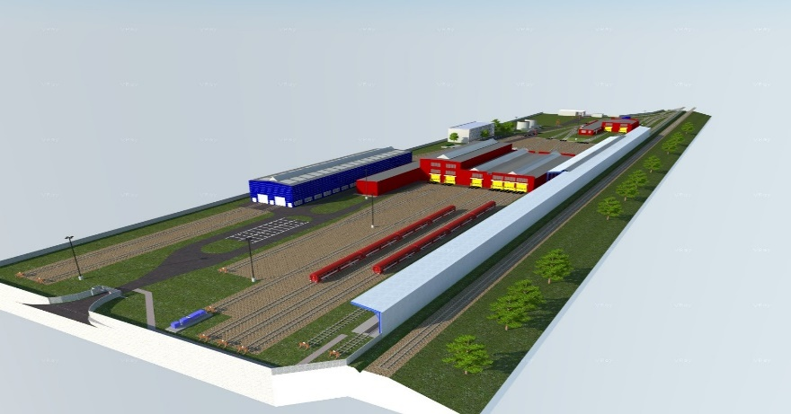
OP Integrated Infrastructure - Introduction
Main activities supported by OPII
PA5 - Railway infrastructure (outside TEN-T CORE)
Construction of technical centres for light maintenance of trains
Electrification of rail-lines
Implementation of ETCS, GSM-R, and TSI TAF/TAP systems
Budget: 332 037 915 €
Contracted: 0,6 %

Slide 11
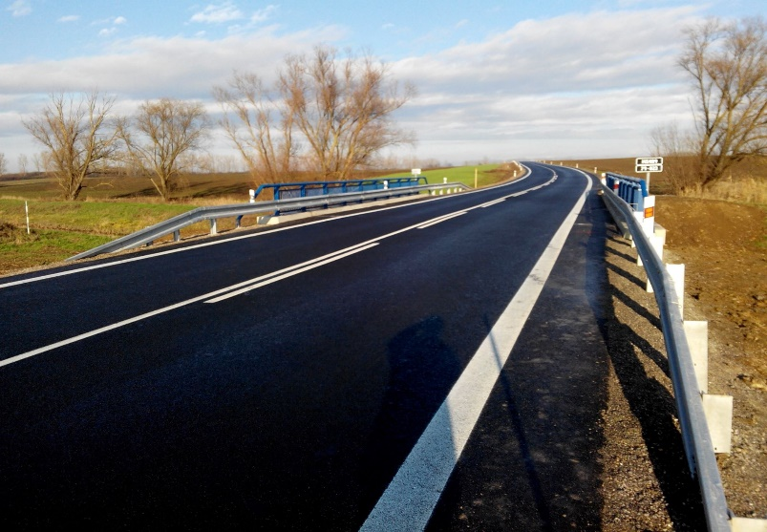
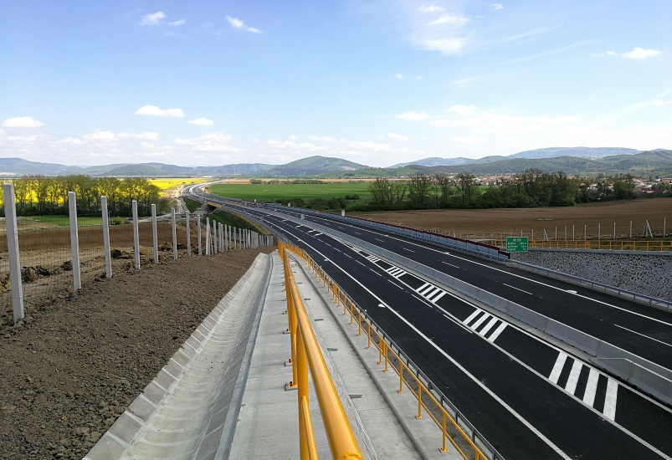
OP Integrated Infrastructure - Introduction
Main activities supported by OPII
PA6 - Road infrastructure (outside TEN-T CORE)
Construction of R2 expressway
Construction and modernisation of first-class roads
Project preparation
Budget: 570 302 622 €
Contracted: 38 %

Slide 12
OP Integrated Infrastructure - Introduction
Main activities supported by OPII
PA7 – Information society
Strengthening ICT applications for e-government, e-learning, e-inclusion, e-culture and e-health
Enhancing cyber-security in the society
Budget: 927 155 226 €
Contracted: 33 %

Slide 13
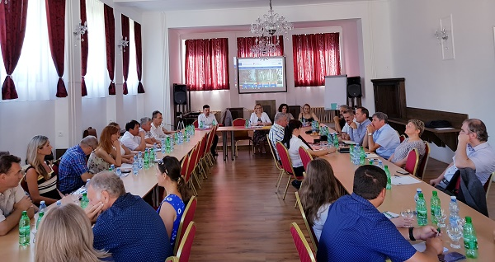
OP Integrated Infrastructure - Introduction
Main activities supported by OPII
PA8 - Technical assistance
Enhancement of professional and language skills of administrative workers involved in the OP implementation
External support for OP implementation
Effective communication of OPII for better public awarness of EU support
Budget: 102 352 942 €
Contracted: 49 %

Slide 14
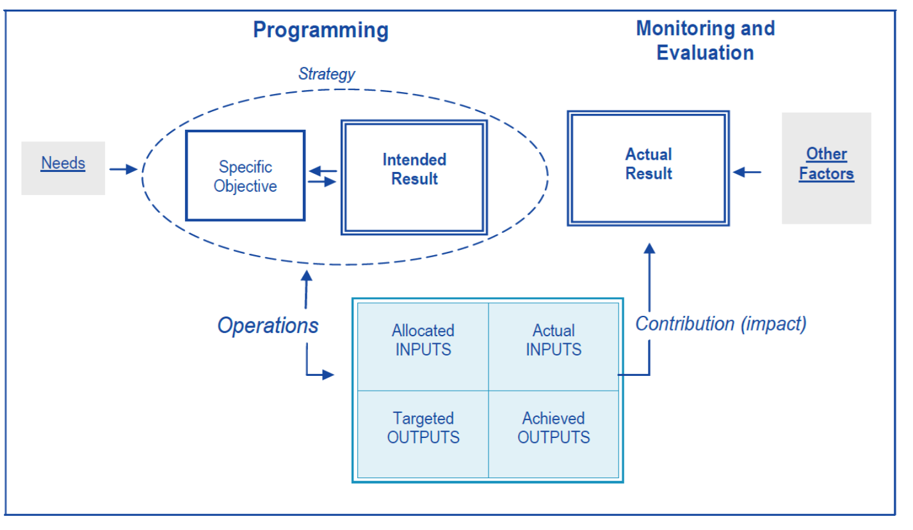
FINANCIAL MANAGAMENT of OPII FUNDS – LOGICAL FRAME

Slide 15
VALUE FOR MONEY - base for evaluation of OPII FUNDS
Financial management of public funds as a learning cycle
(EXPERIENCES)
(APPLICATION)
(REFLECTION)
(BUILD THEORY)

Slide 16
FINANCIAL MANAGEMENT of PUBLIC FUNDS - key elements
EFFECTIVENESS
PUBLIC FUNDS
PUBLIC GOODS
BENEFICIARIES
PRINCIPLES of EFFECTIVE ALLOCATION
DEVELOPMENT of EVALUATION ENVIRONMENT
FOCUS ON SOCIALLY ACCEPTABLE BEHAVIOUR
POSITIVE SOCIO-ECONOMIC CHANGES
BEST PRACTICE SHARING

Slide 17
VALUE FOR MONEY - key evaluation questions
WHAT ARE THE IMPACTS OF INTERVENTION?
ARE THERE ANY DIFFERENCES BETWEEN THE PLANNED AND ACHIEVED IMPACTS?
WHO DOES THE ACHIEVED BENEFITS OBTAIN?
DO THE ACHIEVED IMPACTS DEPEND ON LOCAL AREAS? IF YES, HOW?
WHAT IS THE FINANCIAL VALUE (PRICE) of ACHIEVED BENEFITS FROM THE INTERVENTION?

Slide 18
VALUE FOR MONEY EVALUATION - TARGETING
MONITORING AND EVALUATION OF PUBLIC EXPENDITURES
REVISION OF PUBLIC EXPENDITURES (PRIORITIZATION)

Slide 19
REGISTER OF KEY EVALUATION OBJECTIVES - OP INTEGRATED INFRASTRUCTURE 2014 - 2020
Fulfillment of intentions and expected results (effects) and identification of potential modifications
Suitability of setting up the Management and Control System in terms of efficiency and effectiveness of its operation
Capacity administration for OPII implementation from the side of Managing Authority and Intermediary body of OPII
Absorption capacity according to priority axes (CF and ERDF) and potential for updating of OPII project list
Programme (Project) Compliance with SR / EU State Aid Rules - additional state aid test in line with the consultation and implementation of the decisions given by the Antimonopoly Office of the Slovak Republic
Meeting the stated objectives and impacts of interventions according to OPII priority axes which are connected with funding the construction / modernization of transport infrastructure, renewal of mobile resources and support of the information society

Slide 20
Thank you for your attention
OP Integrated infrastructure 2014 – 2020
Study visit - Taiex Regio
27-th – 29-th May 2019, Sofia

