Slide 1

Cost Benefit Analysis in the Transport Sector…
…and Evaluations
Petr Šváb, Ministry of Transport (CZ)
28/5/2019 Sofia

Slide 2


Content
Briefly about CBA
Departmental Guideline
Practical experience
CBA – ex-post evaluation method?

Slide 3
Cost – Benefit Analysis
appraisal method that provides analysis of social gains (benefits) and losses (costs) that could arise from a project (or programme)
financial analysis (FA) / economic analysis (EA)
for both quality and quantity effects - converts quality into quantity by monetizing
discounting – making current costs and benefits worth more than those occurring in the future
Notes:
Discounting makes current costs and benefits worth more than those occurring in the future because there is an opportunity cost to spending money now and there is desire to enjoy benefits now rather than in the future

Slide 4
Basic Effectiveness Indicators
Net Present Value (NPV)
  difference between discounted total benefits and costs
  for the project to be acceptable, NPV of the project should be positive (NPV>0),
Internal Rate of Return (IRR)
  discount rate resulting in zero FNPV
  for the project to be acceptable, IRR should be higher than disount rate (IRR>discount rate)
  if too high - no need of grant?
Both financial and economic indicators

Slide 5
Ex-ante CBA
for decision making
comparing alternatives
  baseline alternative, no-project alternative (do nothing / do minimum)
  project alternatives
feedback for ex-ante CBA
evaluation or presentation of the effects of project / programme
Ex-post CBA

Slide 6
Departmental Guideline
Departmental Guideline FOR THE EVALUATION OF ECONOMIC EFFECTIVENESS OF TRANSPORT CONSTRUCTION PROJECTS
SUDOP Praha a.s. – external supplier
150 pages + 250 pages of annexes
https://www.sfdi.cz/soubory/obrazky-clanky/metodiky/2017_03_departmental-methodology-full.pdf
Special guidelines for projects of private beneficiaries – multimodal transport, alternative fuel infrastructure, railway rolling stock

Slide 7
Departmental Guideline
Sets rules for economic effectiveness appraisal (EEA)
Mainly CBA, for some types of projects multi-criteria appraisal (MCA)
Primarily, for purpose of OP Transport project selection
Binding for all transport infrastructure projects – project approval by „Ministry of Transport Central Commission“

Slide 8
Procedure and content of EEA
CBA / MCA / other
Assessment of compliance with project objectives
Conclusion
Recommendation and Summary

Slide 9
EEA Scope
Pre-feasibility study - based on the requirements of the study specifications
Feasibility study - for project variants (including no-project variant) financial and economic analysis in full scope → final variant selection (CC)
Project plan - full scope for the selected variant → project approval (CC)
OP Transport project selection (MA) + calculation of the financing gap, sustainability and capital financial indicators can be carried out separately for the part or the whole project stage
Notes:
Different for single project stages

Slide 10
Inputs - FA
  capital expenditure (including initial investment);
  replacement costs of equipment;
  operating costs;
  revenues;
  sources of financing;
  residual value
Notes:
Different for single project stages

Slide 11
Inputs - EA
  capital expenditure and operating costs of infrastructure
  reduction (effect) of general costs of transport of goods or people,
    savings on vehicle operation costs,
    time savings,
  change (effect) of external transport costs in the areas
    reduction of the accident rate,
    reduction of noise emissions,
    reduction of non-greenhouse gas emissions, incl. dust particles,
  reduction of greenhouse gas emissions
Notes:
Different for single project stages

Slide 12
Experience
Not exact method – estimation!
The result is always positive (just few projects were refused)
Result depends on included B / C
Some quality aspects hard to convert – How much costs the human’s life? Landscape character? Landscape fragmentation?
Notes:
Accident with death 20 790 000 CZK / 800 000 EUR / 1,6 mil leva

Slide 13
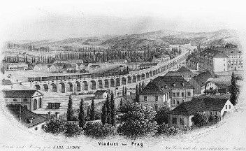
Does not work for „Big visions“
Negrelli’s Viaduct (Prague) x suburban railways
Notes:
unquestionable

Slide 14
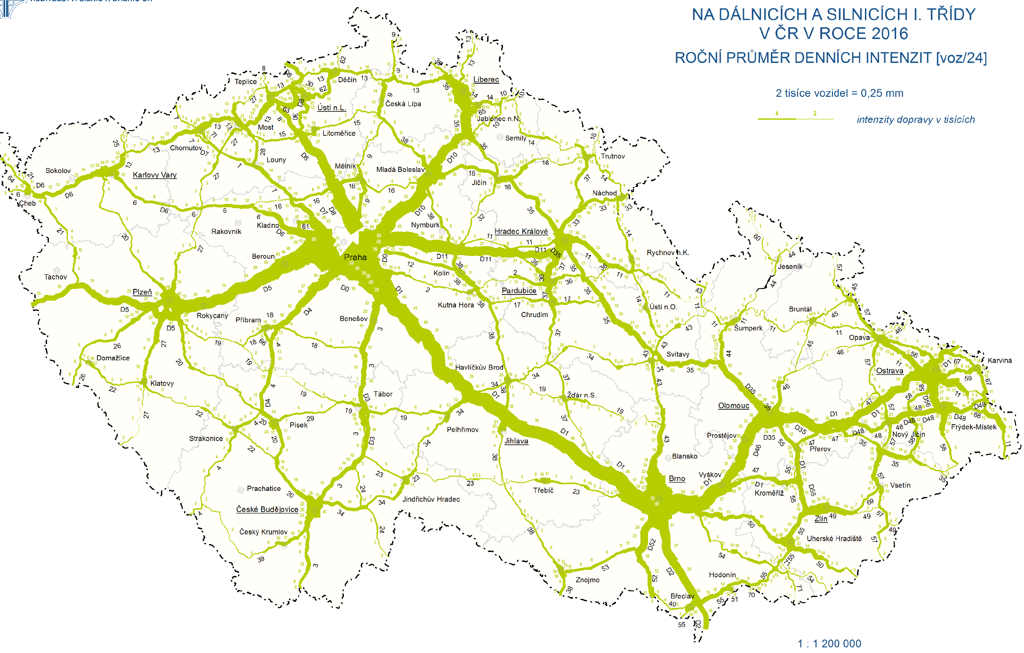
Does not work for „Political objectives“
Core TEN-T Completion
ETCS / GSM-R
Notes:
unquestionable

Slide 15
Experience
Sets clear and single conditions
Single approach – better decision-making
The increasing quality of projects
Transparent – public, EC

Slide 16
CBA for the purpose of the outcome evaluation
Scope
  railway infrastructure
  regional roads (not TEN-T)
Evaluation design – „keep it simple“
Evaluation of few aspects interesting for general public
  Railway infrastructure
  Travel times
  Transport performance
  Railway track capacity
  Safety
  Regional roads
  Travel times
  Road-traffic intensity
  Safety

Slide 17
Data
Same as EEA
  Railway infrastructure
  Travel times
  Number of trains
  Number of passangers
  Number of accidents
  Railway track capacity
  Regional roads
  Road-traffic intensities - inductive-loop detector
  Number of accidents
Floating Cars Data

Slide 18
Issues
Aggregate figures; putting in context
  Statistics at the national level
Verification of the no-project alternative
  Similar tracks – with / without project
  Not realised / delayed project with EEA
EEA - whole track x OP Transport project – track section
Verification of prognoses – evaluation x check / audit
  Mis-trust of beneficiary
EEA - copyright / GDPR

