Slide 1
Role of Evaluation coordination group and Capacity Building Projects in Lithuania Vilija Šemetienė Head of Economic Analysis and Evaluation Division Ministry of Finance, Lithuania
1

Slide 2
Content
Evaluation system in Lithuania
The role of Evaluation Coordination Group
Evaluation capacity building

Slide 3
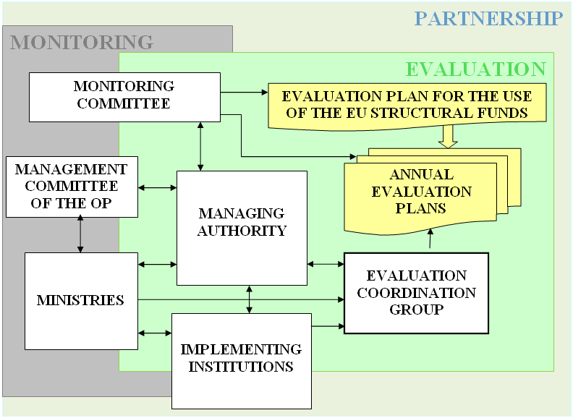
Evaluation System in 2014-2020
Notes:
The EU regulations establish general principles and provisions of evaluation;
National legal acts define the institutional set-up and responsibilities for evaluation as well as the process of evaluation planning and implementation;
The EU Structural Funds evaluation system is based on central steering from the MoF and active involvement of the intermediate institutions (the ministries and other state institutions).
Evaluation system in Lithuania: a centralised approach
During the 2007-2013 programming period, Lithuania developed and put into operation a centralised system for the planning and coordination of evaluation of EU investments. It has been slightly modified in the period of 2014-2020. The system ensures the consistent and systematised evaluation of EU investments and the collection of evidence relevant for decision-making. The scheme provided below shows the actors and their roles in the Lithuanian evaluation system.
Evaluation activities of the 2014-2020 programming period were planned and are carried out in accordance with a general evaluation plan for 2014-2020. To implement this plan, annual evaluation plans are being developed and implemented. They specify responsible institutions, specific evaluation and evaluation capacity building projects (incl. their main objectives, methods suggested and data available, main products), relevant timeframes and financial allocation.
The Ministry of Finance is a Managing Authority, which plays a central role in planning and coordinating evaluations, and commissions a major part (about half) of all evaluations. Other ministries act as intermediate bodies and contribute to the implementation of annual evaluation plans (Ministries of the Environment, the Interior, Health, Education and Science, Social Security and Labour, Transport and Communications and the Information Society Development Committee. In the 2014-2020 period, this function is also performed by the Ministry of Culture and the Ministry of Energy).

Slide 4
Managing authority (Ministry of Finance)
Prepares and submits for MC approval the general Evaluation Plan and annual evaluation plans and its amendments; ensures its implementation;
Organises evaluations of strategic/horizontal level and coordinates the evaluation activities of the intermediate bodies (the ministries);
Monitors the implementation of recommendations provided in evaluations;
Informs the MC and the COM about the results of evaluations, prepares summaries of evaluations;
Implements evaluation capacity building measures.

Slide 5
Intermediate bodies (The Ministries)
Participate at the preparation and amendment of the EP and annual EPs;
Submit proposals to MA for organisation of evaluations and organise them of priority/sectoral level;
Submit information on the results of evaluations, made recommendations and its implementation to MA;
Organise publicity events of evaluation results.

Slide 6
Monitoring Committee
Approves Evaluation Plan for 2014-2020 and any amendments, annual evaluation plans;
Analyses the findings of all evaluations;
Examines the progress made in implementation and follow-up given to findings of evaluations;

Slide 7
Evaluation Coordination Group
Considers annual evaluation plans;
Considers annual evaluation plans;
Analyses the progress of the implementation of annual evaluation plans;
Considers terms of references of the EU structural funds evaluation projects;
Prepares proposals to responsible institutions regarding the evaluation planning and implementation;
Performs other activities related to the coordination of the EU structural funds evaluation.
Analyses the progress of the implementation of annual evaluation plans;
Considers terms of references of the EU structural funds evaluation projects;
Prepares proposals to responsible institutions regarding the evaluation planning and implementation;
Performs other activities related to the coordination of the EU structural funds evaluation.
Analyses the progress of the implementation of annual evaluation Prepares proposals to responsible institutions regarding the evaluation planning and implementation;
Performs other activities related to the coordination of the EU structural funds evaluation.
Notes:
An important role is played by the Evaluation Coordination Group (ECG) in the Lithuanian evaluation system. The real value of the ECG comes with the development and consideration of annual evaluation plans as well as discussions on relevant evaluation themes, scope of evaluations, budget and other issues.
It functions also as a learning network. Institutions can learn about evaluations planned and implemented by other institutions. It helps to prevent the duplication of evaluations and identify evaluation themes, which are relevant for several or all institutions. The format of the ECG proved to be successful as an evaluation monitoring working group initiated by the Ministry of Finance, which often covers the issues relevant for different institutions.
Moreover, the ECG was the main target group of most of the evaluation capacity building measures. Since 2014 its composition has been expanded: currently it involves both the representatives from the ministries and implementing bodies.

Slide 8
Evaluation Capacity Building Activities
The main directions of evaluation capacity building:
Improvement of evaluation quality;
Strengthening of human resources capacities;
Promoting the use of evaluation results;
Incentives for supply side.
Notes:
Improvement of evaluation quality. The measures in order to reinforce the quality of evaluation reports are as follows: (i) Drafting and structuring the Terms of Reference with clear evaluation aims, objectives, criteria and evaluation questions; (ii) use terms of reference and public procurement requirements as quality assurance tools (iii) take a systematic approach to assessing quality of evaluation reports and aplying quality control measures (iv) build evaluation capacity through small-scale internal/participatory evaluations.
Strengthening of human resources capacities. Efficient implementation of Structural Fund evaluation function requires not only sound legal and organisational basis, but also adequate human resources. Within Structural Fund administration there is a clear need for sustained capacity building measures due to staff turnover, little prior experience in evaluation and various challenges still arising in planning and implementing evaluation projects. To strengthen human resources and minimize the negative effects of the turnover this study recommends the following measures: (i) measures aimed at reducing workload of personnel in charge of evaluation; (ii) training; (iii) making use of external expertise.
Promoting the use of evaluation results. The measures in order to ensure better utilisation of evaluation results are as follows: (i) more evaluations that meet national evaluation needs, (ii) strengthening co-operation with the Monitoring Committee in order to ensure more attention to evaluation from the decision-makers, (iii) encouraging interactions between Structural Fund and the national evaluation systems and (iv) better dissemination of information on evaluation, (v) monitoring of implementation of evaluation recommendations;
Incentives for suply side. : (i) using public procurement rules to influence the evaluation supply, (ii) targeting and communicating with academic institutions in order to encourage their involvement in Structural Fund evaluation, (iii) involment experts in differen evaluation events and trainings.

Slide 9
Evaluation Capacity Building Activities
During 2007-2018 years 6 capacity-building projects were implemented in Lithuania:
training activities for civil servants and potential evaluators;
methodological guidelines and other evaluation documents;
evaluation publicity events for stakeholders and partners (8 International Evaluation Conferences).
Notes:
2007-2018 6 CBS projects were implemented (2008–2009, 2010–2011, 2012–2013, 2014-2015).
Results of CBS projects:
More than 10 methodological documents,
20 training events,
8 international evaluation conferences,
evaluation publicity measures,
events for evaluation society,
assessments of the evaluation quality and the use of results.
Thematic evaluations were carried out:
Meta evaluation of the quality of EU structural assistance evaluations;
Evaluation of the use of evaluation results of EU structural assistance (3 times )

Slide 10
Evaluation Standards
The purpose of standards for evaluation:
To improve the evaluation process
To enhance the evaluation quality
To improve the use of evaluation results
The nature of standards for evaluation:
Standards as methodological guide;
Standards include all evaluation implementation stages;
Standards define distinguishing features from other evidence-based management tools;

Slide 11
Supply-side and demand-side factors affecting the quality of evaluations
Supply-side factors: competence of evaluators, good project management and cooperation
Demand-side factors:
better technical specifications, longer project duration, better access to data
Notes:
Evaluation society
The supply-side of evaluation became competitive enough during 2007-2013:
About 15 evaluation service providers.
On an average 3 proposals in evaluation service tenders.
Higher-quality and more detailed proposals.
Rarely, but still occurring not so good quality proposals and evaluations, too.

Slide 12
Evaluation Plan for 2014-2020
The evaluation plan – a strategic planning document establishing the goals and objectives of evaluation of the use of EU Structural Funds assistance for 2014-2020;
Two main objectives of the EU Structural Funds evaluation:
To organise and implement evaluations, which correspond to the requirements of the EU regulations and national evaluation needs;
To strengthen the evaluation capacity in Lithuania.
Two main types of evaluation:
Impact evaluation;
Implementation evaluations.
Notes:
Evaluation plan is an Evaluation Strategy for 2014-2020 programming period.
About 70 evaluations are planned to carry out acording the Plan. About 40 – impact evaluations; about 15 – interim evaluations, in which will be assesed progress of implementtaion of OP.
6 annual evaluation plans are approved.

Slide 13
THANK
YOU!
Vilija Šemetienė
vilija.semetiene@finmin.lt

