Slide 1
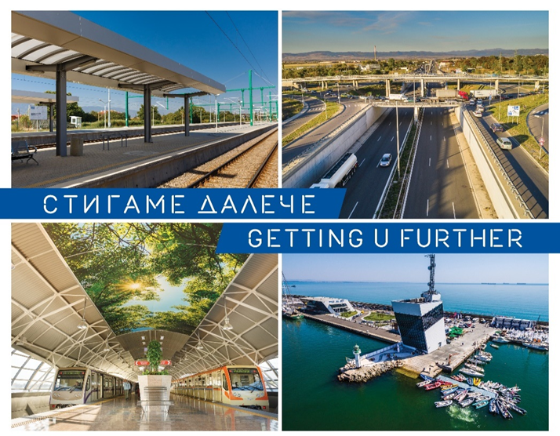
CITIZEN’S SUMMARY ON
2019 ANNUAL IMPLEMENTATION REPORT
Operational Programme on
“Transport and Transport Infrastructure”
2014 - 2020

Slide 2
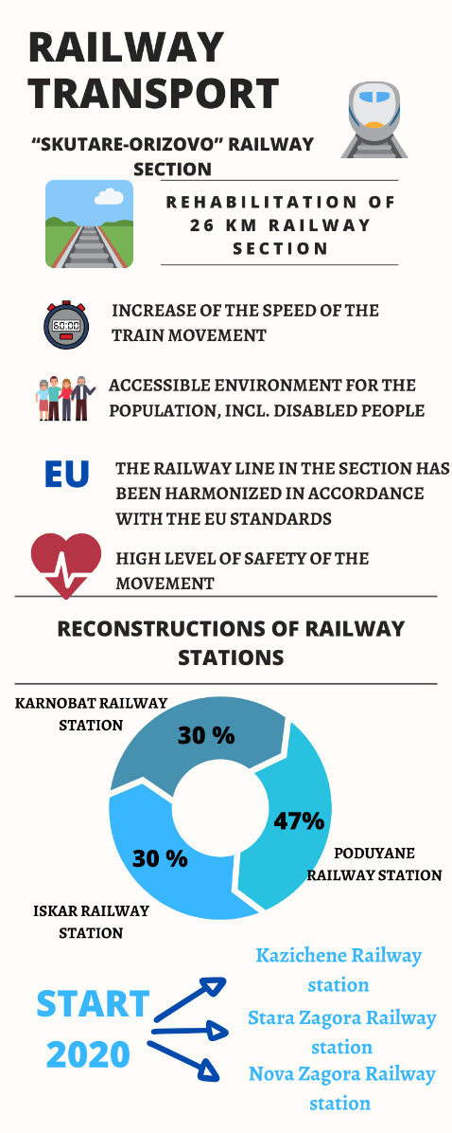
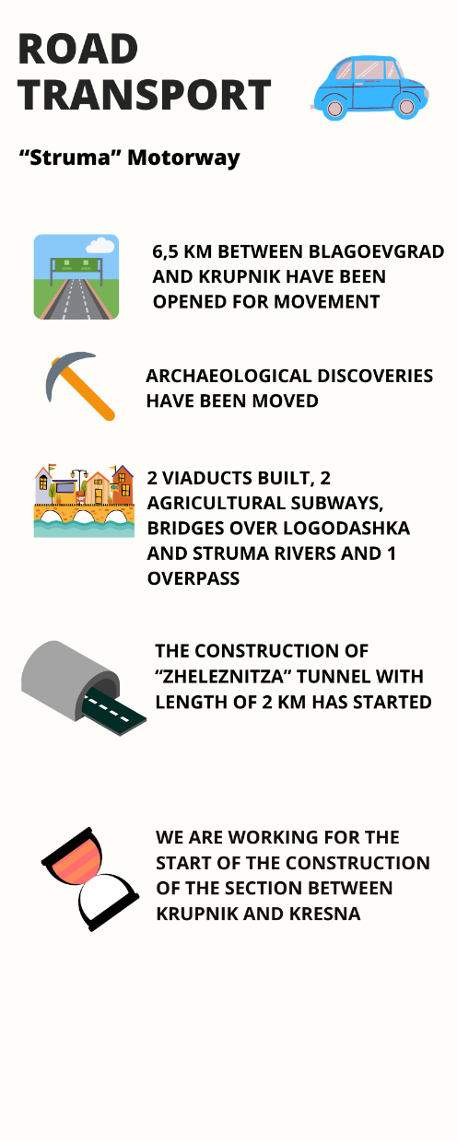
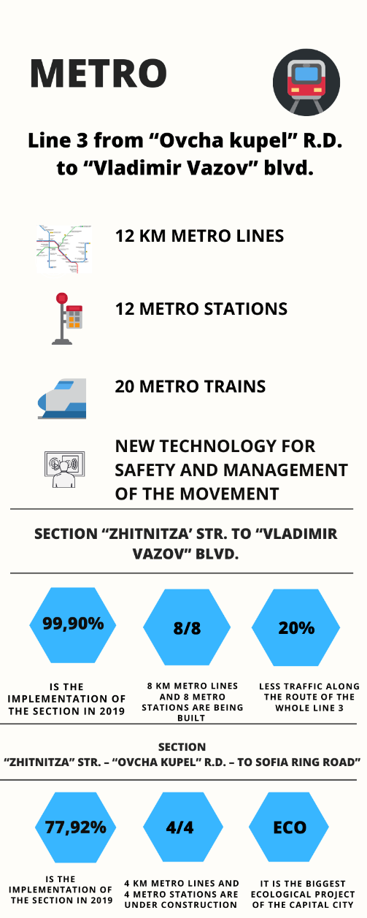
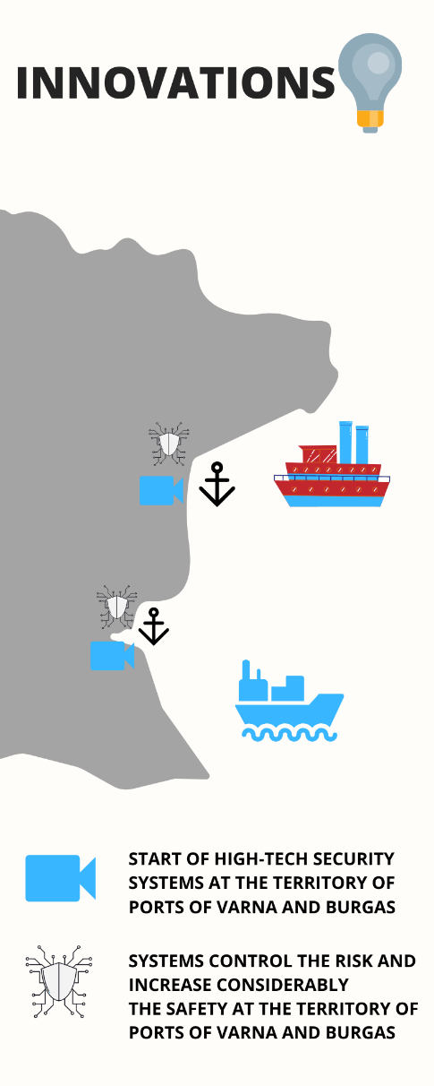
OPTTI in 2019

Slide 3
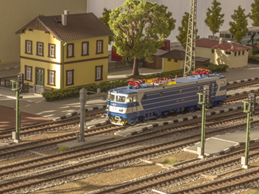
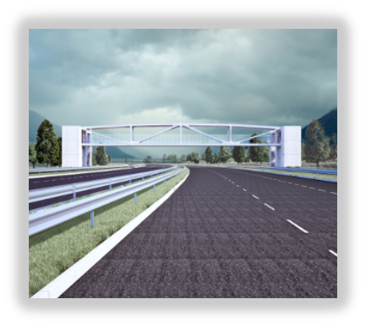
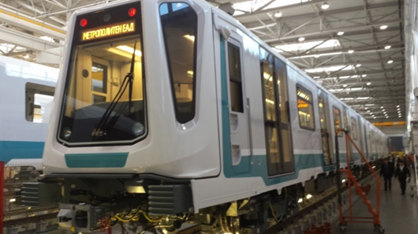
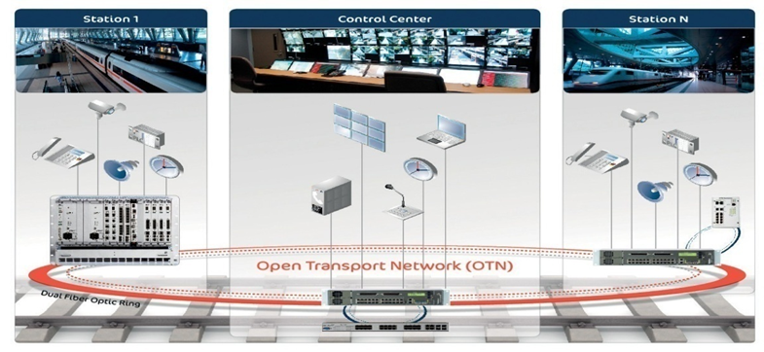
Programme’s budget
633 million EUR railway infrastructure
OPTTI implementation goes through different challenges, difficulties, but nevertheless meets success.
In 2019 the road sector projects keep the pace in positive direction.
Both major projects for the construction of Sofia metro Line 3 are being implemented.
The rate of investments in the railway sector and in innovation projects has remained not enough sufficient.
Due to the fact that main milestones have not been achieved a reallocation of the performance reserve between the Priority Axes of the Programme has been undertaken in 2019.
714 million EUR road infrastructure
424 million EUR metro and intermodality
70 million EUR management and service innovations

Slide 4
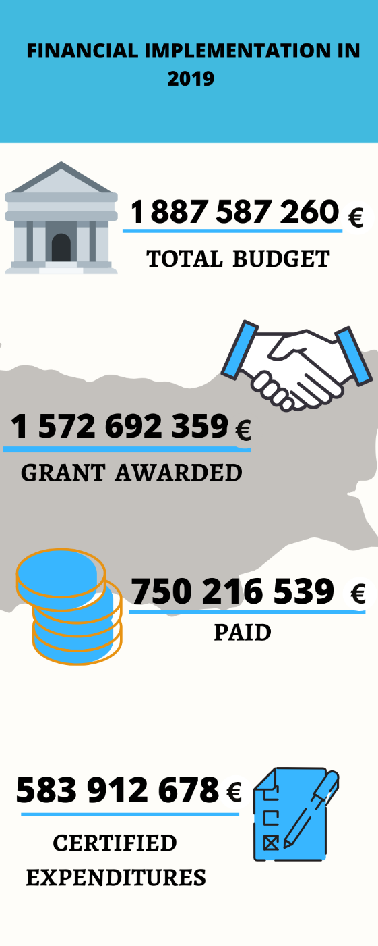
Financial implementation
Each operational programme has a financial plan year by year.
The funds planned for a given year must be converted into payments by the end of the third year from the planned year.
If the milestones are not achieved, funds will be lost concerning the application of the so called “decommitment rule (N+3)“.
Nevertheless of the difficulties met, the overall financial target for the Programme has been achieved with more than 112% in 2019 and no loss of funds is being expected.

Slide 5
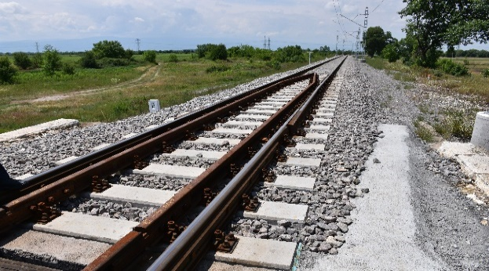
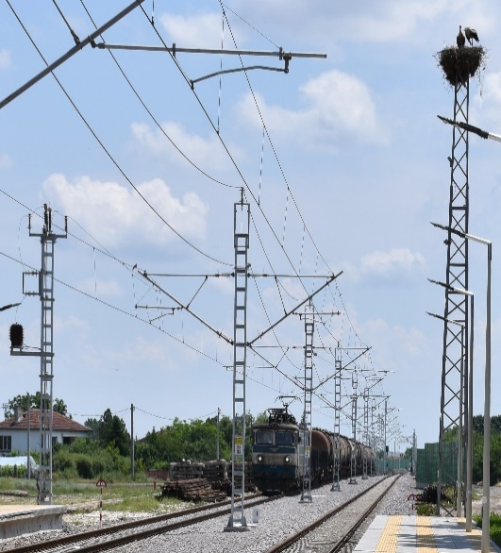
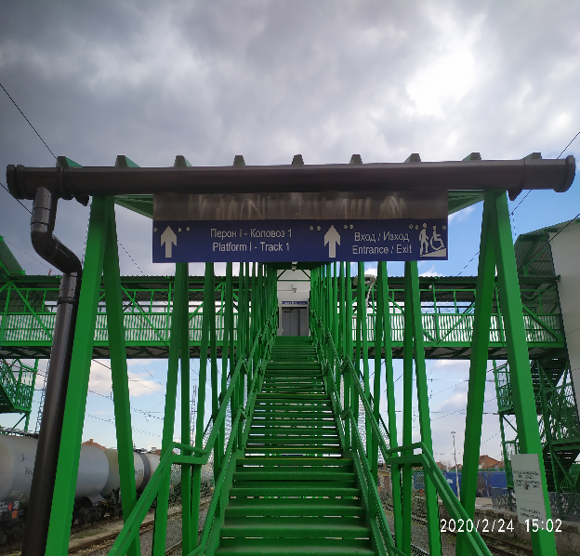
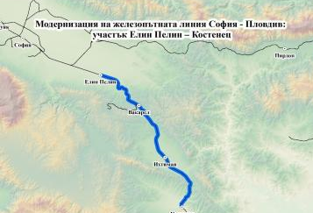
Railway transport
Railway section „Skutare – Orizovo“
The reconstruction of 26 km railway section “Skutare - Orizovo” (part of the railway line “Plovdiv – Burgas”) has been completed.
Rehabilitation activities have been carried out on the railway and the contact network, including on the main tracks at Manole and Belozem stations.
With the implementation of the contract was achieved:
increase of the speed of trains;
ensuring a high degree of traffic safety;
accessible environment for the population, including disabled people;
The railway line in the section has been harmonized in accordance with the EU standards.
The contract for the modernization of the railway section “Elin Pelin – Vakarel” (part of the project “Elin Pelin – Kostenetz”) has been signed.
The section is about 20 km long and is the most difficult for implementation along the entire route.
Its scope includes the construction of the largest railway tunnel in Bulgaria, with a length of 6,8 km.

Slide 6
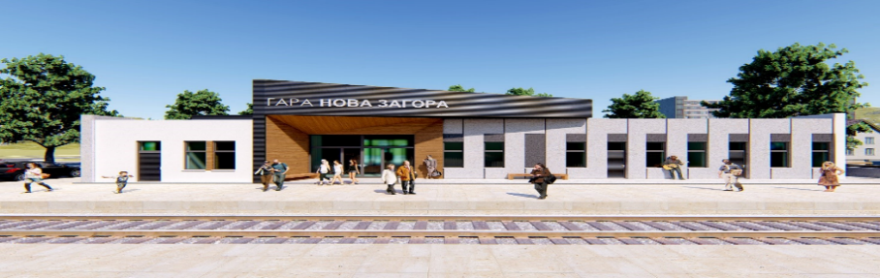
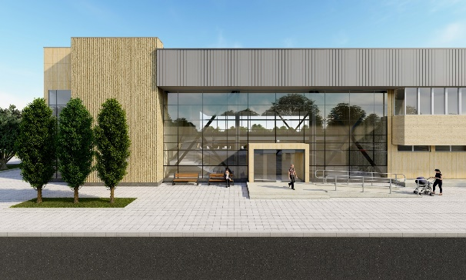

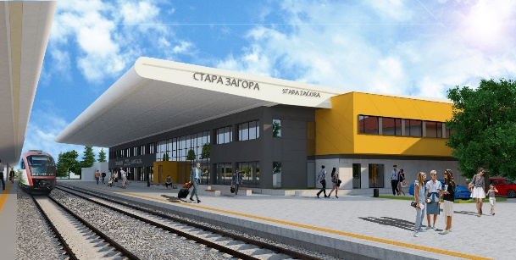
Railway transport (railway stations)
The reconstruction of six railway stations is financed under OPTTI:
Poduyene, Iskar, Kazichene, Karnobat, Stara Zagora and Nova Zagora
Visualization of railway station Nova Zagora
Visualization of railway station Karnobat
The reconstruction of three railway stations has started – Karnobat, Poduyene and Iskar.
The physical implementation of the projects is as follows: for Karnobat - 30%, for Poduyene – 47% and for Iskar – 30 %.
Visualization of railway station Stara Zagora
The construction works for the other three railway stations: Kazichene, Stara Zagora and Nova Zagora are planned to start in 2020.

Slide 7
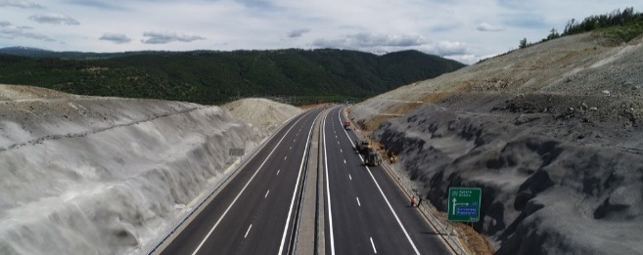
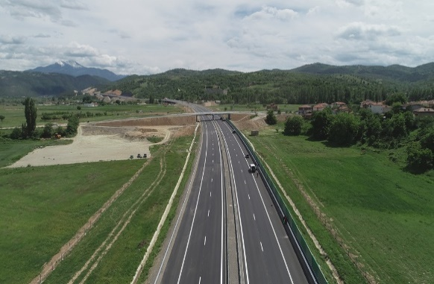
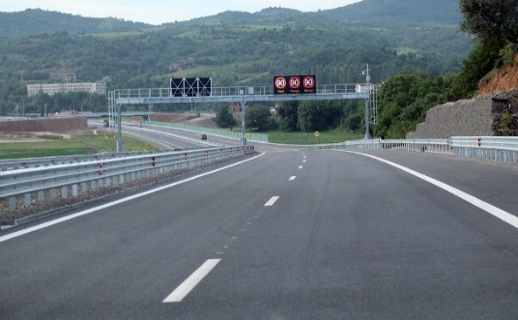
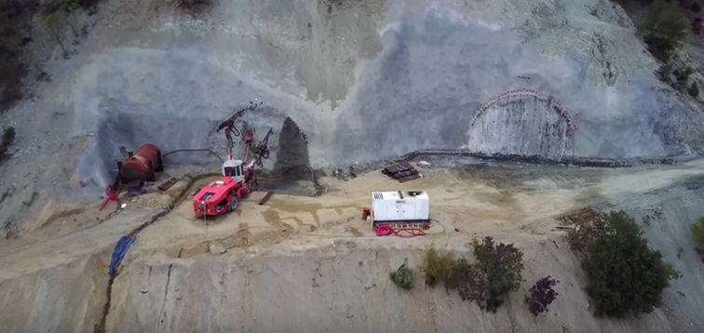
Road transport
6,5 кm under Lot 3.1 of “Struma” Motorway were completed and opened in May 2019.
The archeological artifacts discovered on the motorway route near Pokrovnik village have been removed.
Two viaducts, two agricultural underpasses, two bridges over Logodashka and Struma river and one overpass have been built.
On national level measures are being taken in order to mitigate the negative environmental impact under Lot 3.2 of “Struma” Motorway construction. It is necessary to meet all European environmental norms and requirements.
The actual construction of the “Zheleznitza” tunnel and the adjoining road sections has been commenced.
The tunnel will be the longest road tunnel built so far in Bulgaria - 2 km long.
It will have two separate traffic pipes and all the necessary lighting, ventilation, video, fire alarm systems as well as intelligent traffic management systems, etc.

Slide 8
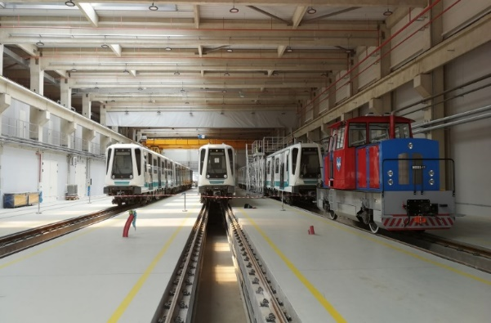
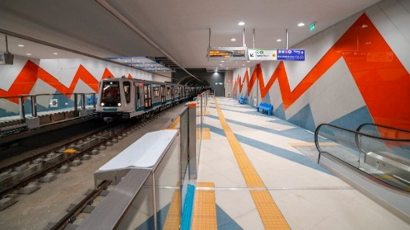
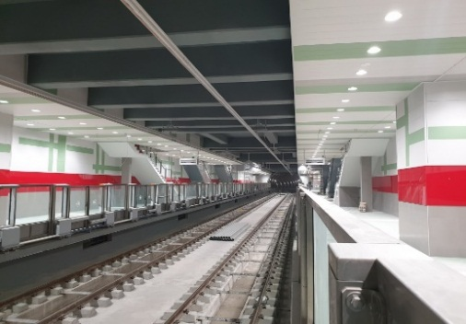
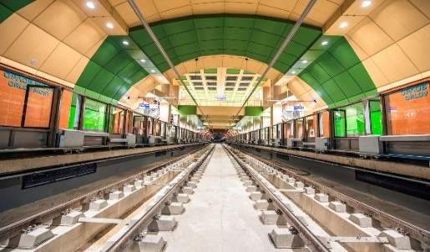
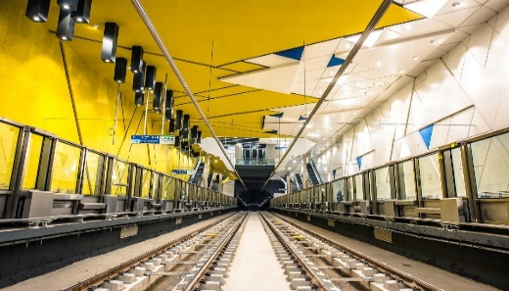
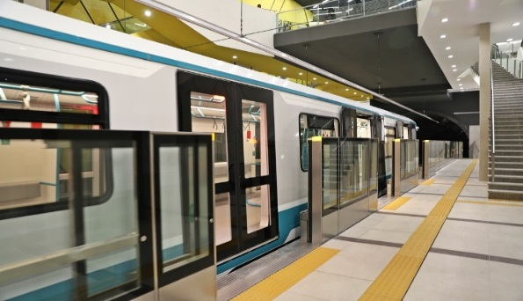
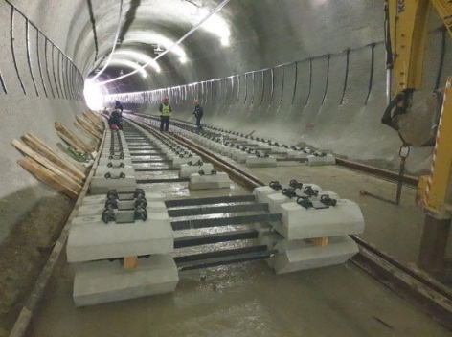
Metro
8 km of metro lines and 8 metro stations under the project for the central section from “Zhitnitza” street to “Vladimir Vazov” blvd. from Sofia metro Line 3 have been completed. The section is planned to be put into operation in 2020.
20 metro trains were delivered to the Zemlyane depot and tested in a test section. The trains have the possibility of autonomous unmanned control.
Sofia metro Line 3 will have a new generation of automation and traffic safety and control systems.
Metrotrains
MS “Krasno selo”
MS “Blvd. Bulgaria”
MS “Orlov most”
MS “NDK 2”
4 km of metro lines and 4 metro stations are being constructed on extension of Sofia metro Line 3 from “Zhitnitza” str. – “Ovcha Kupel” R.D. – to Sofia ring road”
Sofia metro Line 3 is the biggest ecological project in the capital. With its construction 20% reduction of the traffic is expected in the sections through which the metro passes.
Automatic platform partition doors
Laying of Metrolines

Slide 9
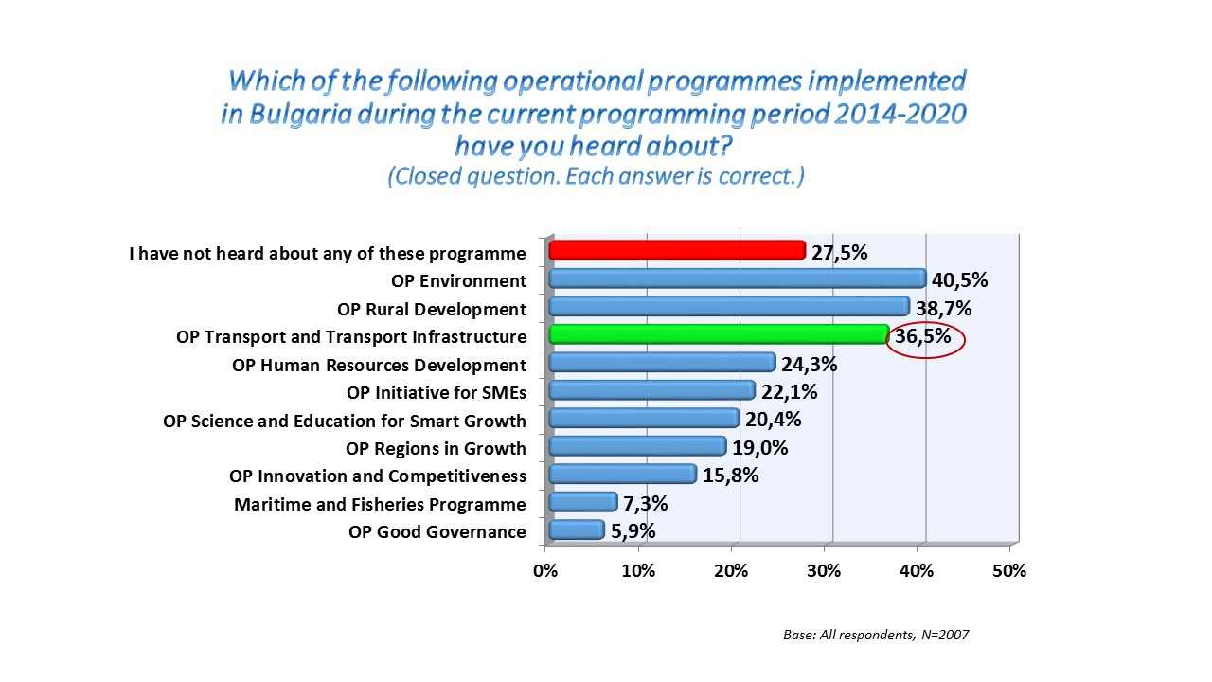
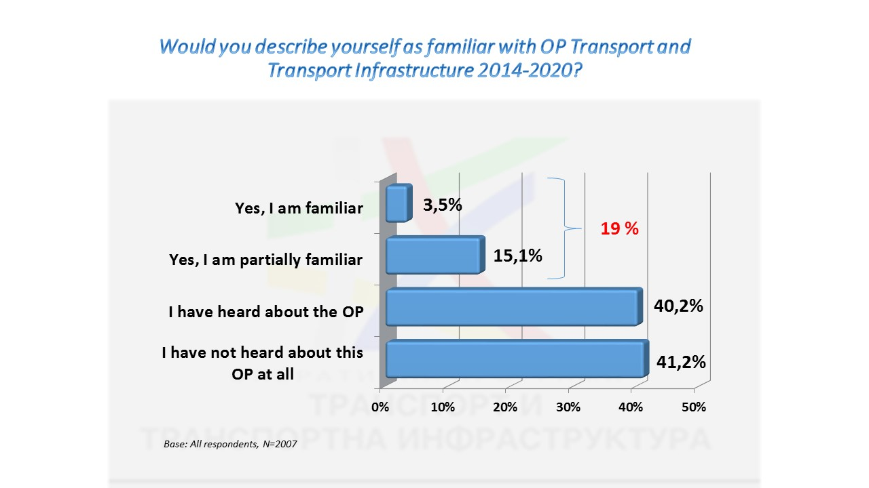
Sociological survey
In April 2019 the First nationally representative survey for OPTTI among outer target groups, aged 15+ years, was conducted.
Various topics were covered: information about the travel patterns of the Bulgarians; the ways they get informed and their media behavior; opinion about infrastructural projects, financed with the European support, etc.

Slide 10
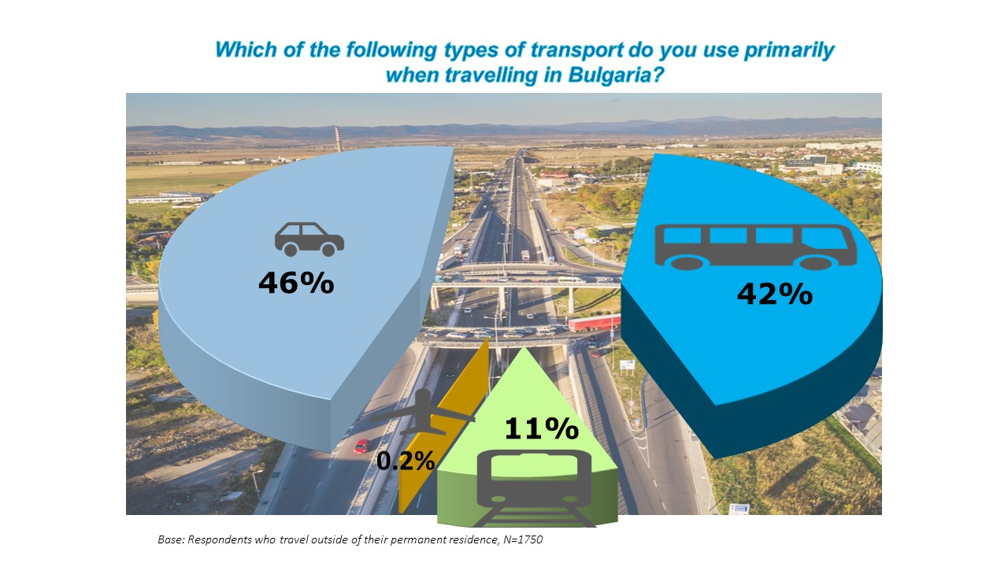
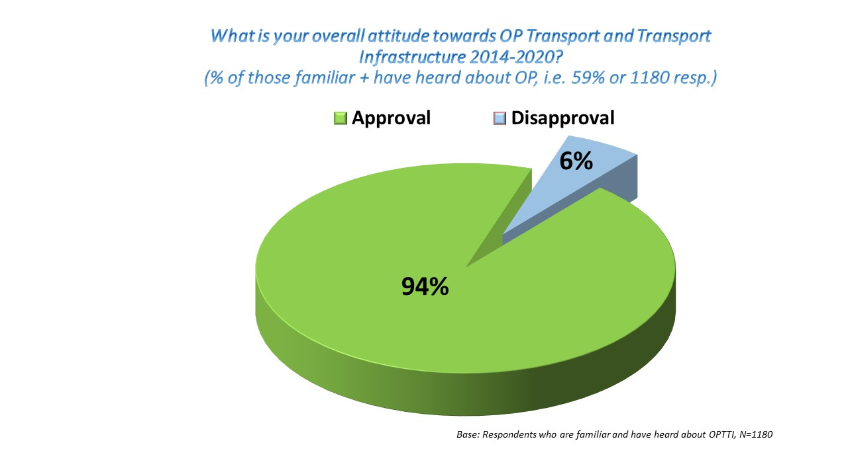
Sociological survey
You can find more information about the survey and OPTTI 2014-2020 here: https://www.eufunds.bg/bg/optti/node/3127

Slide 11
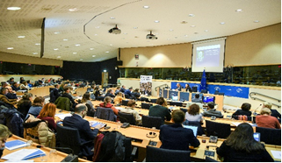
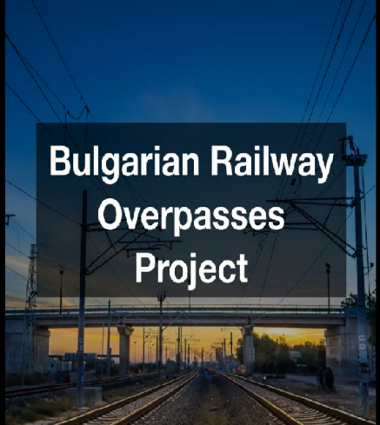

Information and communication
The project for the extension of Sofia metro had been presented in front of participants in a seminar for journalists in Brussels about “Kaleidoscope of the European investments today and tomorrow“
OPTTI railway project has been awarded in a competition of the European Commission under the initiative “Europe in my region“:
https://www.youtube.com/watch?v=6HkqaZqJIbE
Few of the Bulgarian infrastructural transport projects, built with the financial support of OPTTI, have been distinguished in another competition of the European Commission and as an award printed on post cards

Slide 12

OPTTI in the digital space
OPTTI Internet site has become part of the common Internet portal for information and management of the Structural and Cohesion Funds in Bulgaria: https://www.eufunds.bg/bg/optti
Instagram profile of OPTTI has 133 subscribers and more than 170 actual photos and videos of the projects of the programme published.
The most watched video is about the newly constructed metro station “Krasno selo“ – ït has reached almost 1000 users of the platform.
https://goo.gl/3lEwuB
The official You tube channel of OPTTI has about 500 thousands views and more than 870 subscribers.
The most views video-material is “Struma” motorway: “Krupnik – Kresna” - 3D visualization of Lot 3.2.
https://goo.gl/n6QagT

